Slide 1
How to Become a Successful Core Preceptor
Richard Feinberg, Ph.D.
Assistant Dean for Basic Science Education and Faculty Development
Rutgers New Jersey Medical School
Member, Master Educators’ Guild
MSB C-642B 2-5405 feinberg@njms.rutgers.edu

Slide 2
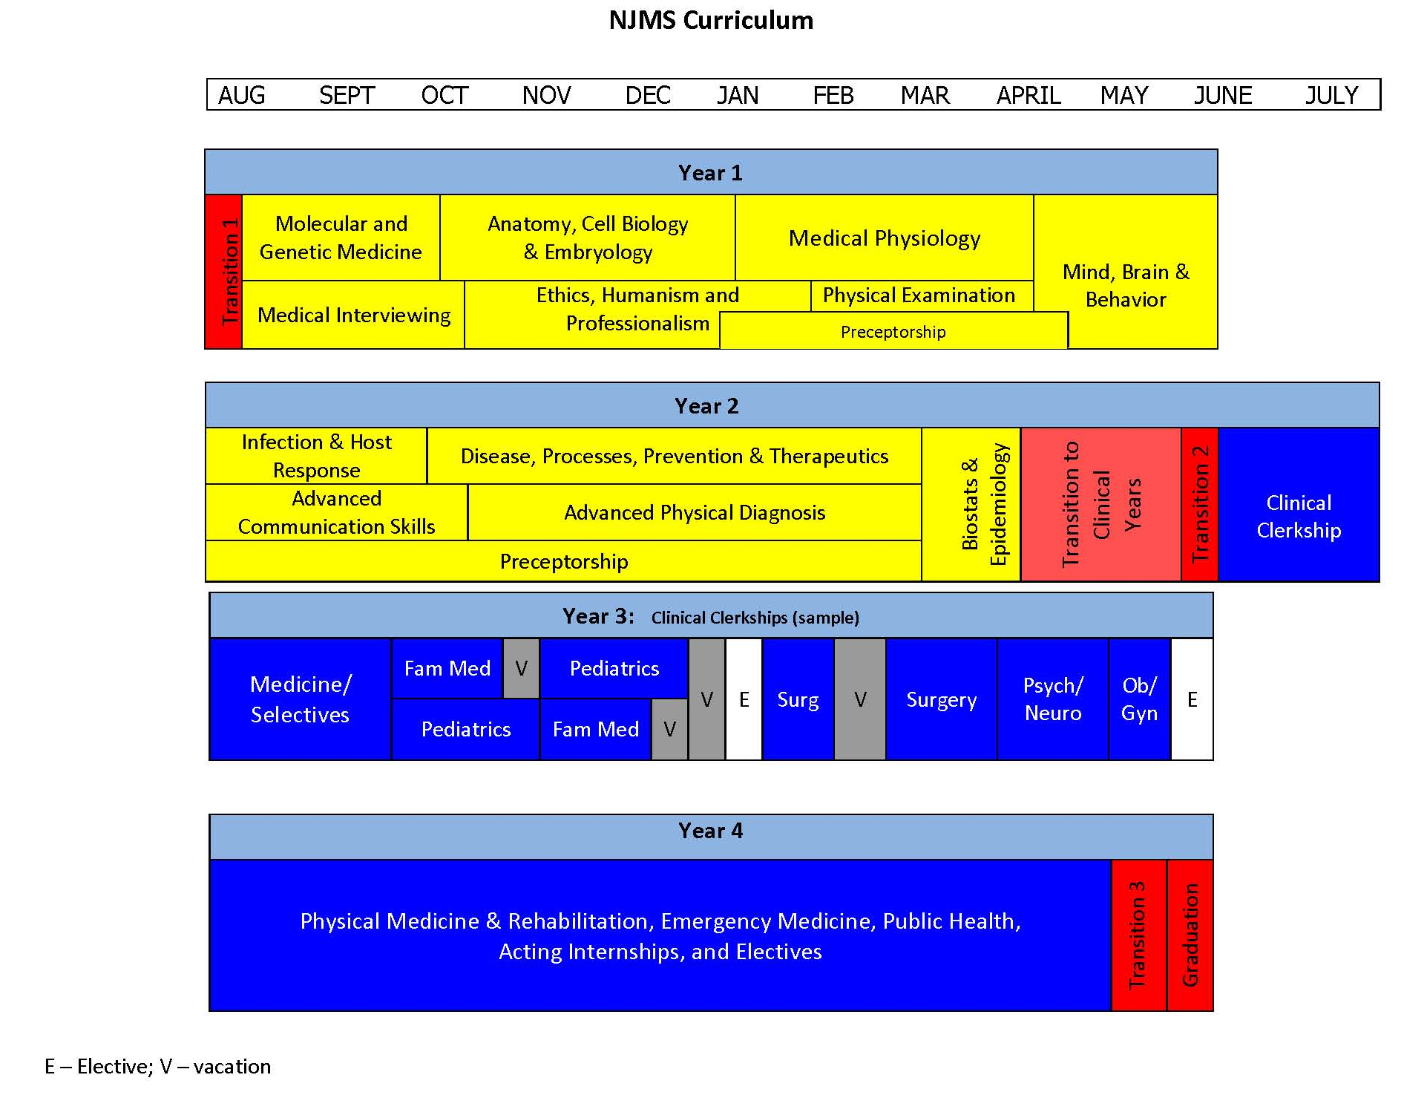
NJMS CURRICULUM AT A GLANCE
Notes:
Go to NJMS website

Slide 3
NJMS Curriculum Goals
Mastery of clinical knowledge with basic sciences integration
Excellence in clinical skills
Excellence in professionalism and humanism
Commitment to the health of the community and appreciation of social and cultural diversity
Dedication to lifelong learning
Development of effective education and communication skills
LCME

Slide 4
Pedagogy
Passive
Lecture
Podcasts
Active (Role as a Facilitator)
Small Group Activities
  Team-Based Learning
  Case-Based Learning
  Problem-Based Learning
  Discussion Groups
  Laboratories
  Bedside
Notes:
Teaching is an Art Form – it requires craft , sensitivity, creativity and intelligence. There are many ways to be successful, however, there are well documented Best Practices for success. Each of you will develop your own style.

Slide 5

Lecture Checklist
1. Know your audience
2. Know the time frame
3. Organize the content
4. Select a manageable number of objectives
5. Choose appropriate images to illustrate the topic
6. Tell a story – Introduce, develop and summarize
Notes:
As a result of feedback from Dr. Oleske - Move tell a story to last, 5 becomes 4 and 6 becomes 5. Clinical cases, images – Make the presentation visually interesting

Slide 6
Get Involved
What do the students already know?
What will they be learning next?
What types of questions should I write?
How available do you need to be to help students?
Notes:
Assume nothing for first bullet,. Last one can be foolow up becasiue teaching gos on in many places.

Slide 7
Steps in Teacher Development
Find a mentor
Learn from a good teacher
Prepare and Practice
Create a Teaching Portfolio
Ask for Feedback (student evaluations)
Resources
Course and Clerkship Directors
Members of the Master Educators‘ Guild
Office of Education
Faculty Development Programs
Assistance with Educational Technology contact: http://it.njms.rutgers.edu/
Notes:
Prepare and practice on same line. Ask for feedback and modify based on that feedback.

Slide 8
One Minute Preceptor
Get a commitment
Probe for supporting evidence
Teach general rules
Reinforce what was done right
Correct mistakes
Notes:
Take advantage of every teaching moment- carpe diem (seize the moment)

Slide 9
Use the One Minute Preceptor
Get a commitment
“What do you think is most likely behind this man’s delirium?”
Probe for supporting evidence
“Did you consider any alternative diagnoses? What makes you favor pneumonia?
Teach general rules
“Consider the possibility of a urinary tract infection in any elderly person with delirium.”
Reinforce what was done right
“You were right to do a head-to-toe examination to evaluate delirium.”
Correct mistakes
“Those fine crackles in the chest are more suggestive of heart failure than of pneumonia.”

Slide 10
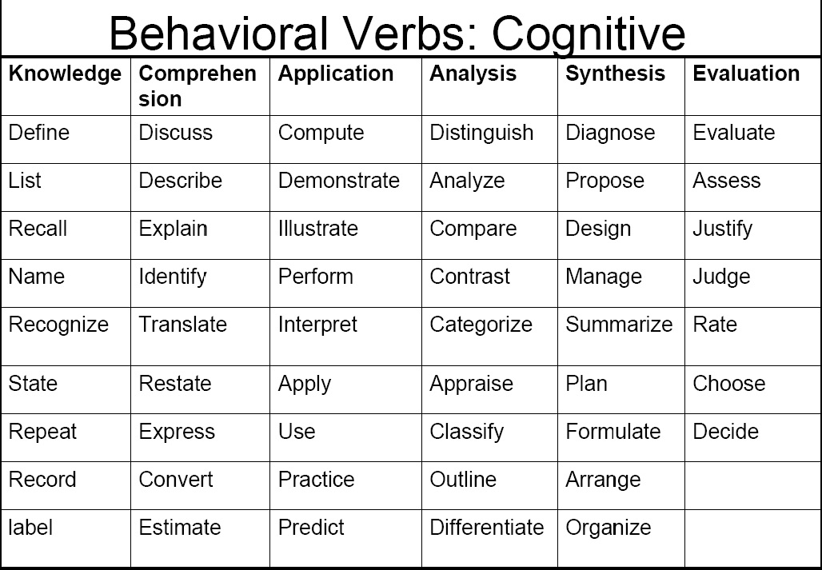
Words to Avoid When Writing Learning Objectives:
Know • Learn • Increase • Become • Understand • Appreciate • Improve
Notes:
Title – writing learning objectives, add recognize to top of last column, reconsider to last column. Last box would be evaluate

Slide 11

Use Objectives to Align Content with Exams
Content Exams
Objectives
Define, Describe, Distinguish, Compare and Contrast, List, Explain, Etc.
Notes:
Test on what you taught.

Slide 12
Recipe for Feedback
Setting – Comfortable and private
Portion size – two or three (adjust to taste)
Measurements - Give accurate and clear feedback about particular behaviors
Results - The goal of feedback is to improve performance - narrow the gap between actual and desired performance
  Sufficient, Timely, Regular, Relevant

