Slide 1
Preview Podcast of Membranes

Slide 2
At the end of this lecture you should be able to:
Describe the biochemistry of the membrane and explain the fluid mosaic model of membrane structure
Compare and contrast integral membrane proteins and peripheral membrane proteins
Explain the importance of freeze-fracture in understanding membrane morphology
Describe the location and function of the glycocalyx
Define membrane domains and lipid rafts
State the role of membranes in cell signaling
Give examples of how the membrane functions as a permeability barrier
Point out the importance of membranes in cellular compartmentalization
Notes:
New for 2009

Slide 3
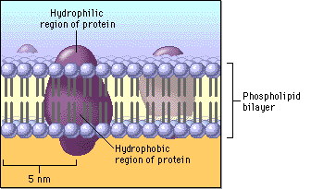
Describe the biochemistry of the membrane and explain the fluid mosaic model of membrane structure
Membrane lipids
Membrane proteins
Integral
Peripheral
Lipid-anchored
Notes:
Membrane lipids – phospholipids, glycolipids and cholesterol. Two leaflets having polar heads and non-polar tails. Phospholipids are amphipathic – having one portion soluble in water and one portion not soluble. Proteins pass thru the membrane, are associated with one side or the other or are anchored by lipids.
Think of icebergs floating in a sea of lipid.

Slide 4
Compare and contrast integral membrane proteins and peripheral membrane proteins
Notes:
Integral membrane proteins are embedded in and penetrate the lipid bilayer. Peripheral membrane proteins can be associated with the inner or outer leaflet.

Slide 5
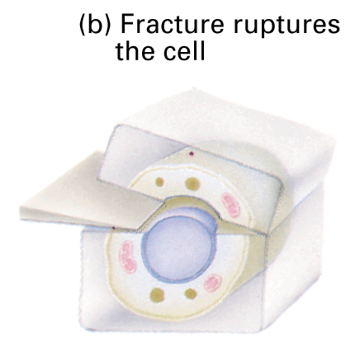
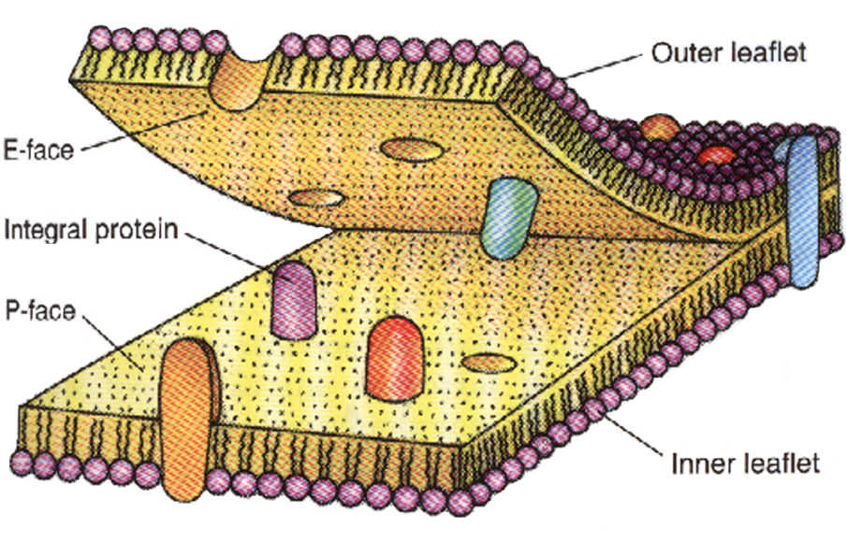
Explain the importance of freeze-fracture in understanding membrane morphology

Slide 6
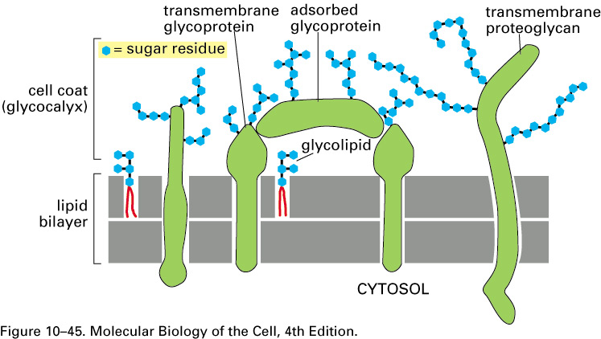
Describe the location and function of the glycocalyx
Notes:
The glycocalyx (cell coat) is only found on the outer leaflet of the lipid bilayer.
Protection – net negative charge repels proteins
Receptors for binding ligands
Facilitates cell-cell recognition
Blood group antigens are due to the presence of specific carbohydrates on the surface of the RBC plasma membrane. The presence or absence of particular sugars associated with the glycolipids accounts for the different blood groups.
Sperm-egg binding is also based on cell surface carbohydrates.

Slide 7
Define membrane domains and lipid rafts
Notes:
Polarized Cells – apical and basolateral domains.
Lipid Rafts – flat regions of the membrane that are rich in cholesterol and sphingolipids . These floating platforms may help to concentrate particular proteins thereby organizing the membrane into functional compartments.

Slide 8
State the role of membranes in cell signaling
Notes:
Endocrine Endocrine, Paracrine (Mast cell) and Autocrine signaling (development) – long distance, local, self.
Endocrine acts on distant targets
Paracrine acts on neighboring cells. Neuronal acts via synapses (cells in close proximity)
Autocrine – immune response to antigens, uncontrolled growth of cancer cells

Slide 9
Give examples of how the membrane functions as a permeability barrier
Notes:
Membranes provide a selectively permeable barrier. Much like a moat around a castle provides a barrier, both have bridges which allow for the inward and outward movement. Membranes transport solutes and ions, sometimes across their concentration gradients.

Slide 10
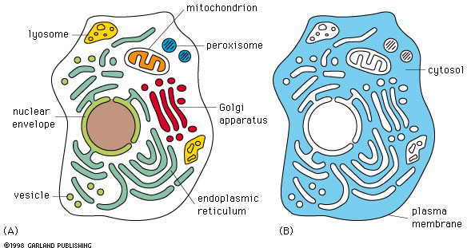
Point out the importance of membranes in cellular compartmentalization
lysosome
Notes:
Establishes microenvironments within each organelle that allow for unique (specific) reactions to be carried out. Substrates, enzymes and pH vary from one organelle to another.

