Slide 1
Review Podcast of Membranes

Slide 2
At the end of this lecture you should be able to:
Describe the biochemistry of the membrane and explain the fluid mosaic model of membrane structure
Compare and contrast integral membrane proteins and peripheral membrane proteins
Explain the importance of freeze-fracture in understanding membrane morphology
Describe the location and function of the glycocalyx
Define membrane domains and lipid rafts
State the role of membranes in cell signaling
Give examples of how the membrane functions as a permeability barrier
Point out the importance of membranes in cellular compartmentalization
Notes:
New for 2009

Slide 3
Plasma Membrane
ed
Notes:
The bilayer is composed of phospholipids, glycolipids and cholesterol. The phospholipids are amphipathic- a polar hydrophilic head faces the aqueous environment while the two nonploar tails project into the middle of the membrane.
Proteins pass thru the membrane, are associated with one side or the other or are anchored by lipids.
Cell coat only on the outside of the membrane, has a negative charge to protect against random encounters with inappropriate proteins.
Domains, microdomains, caveolae and lipid rafts.

Slide 4
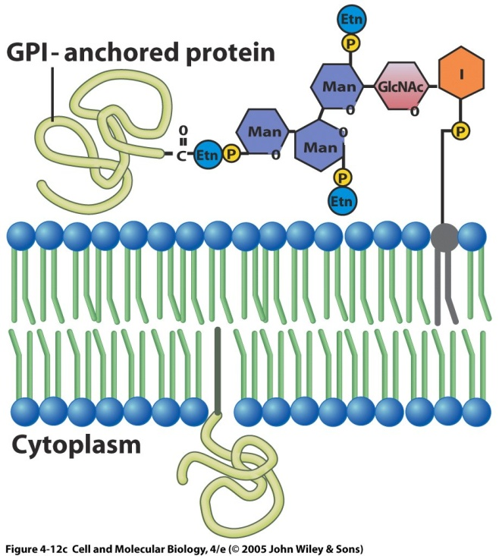
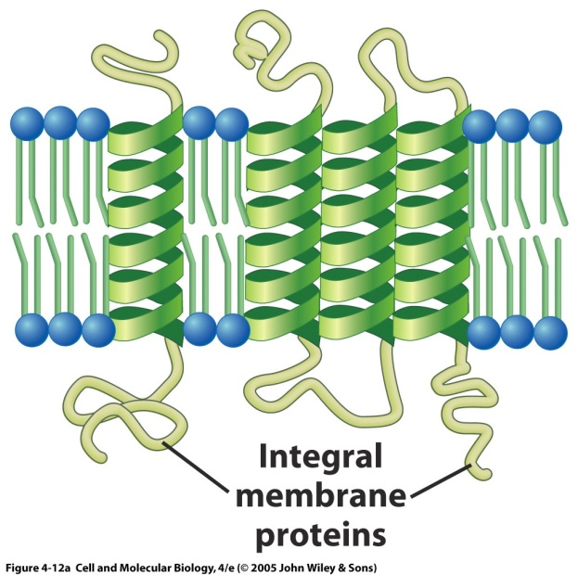
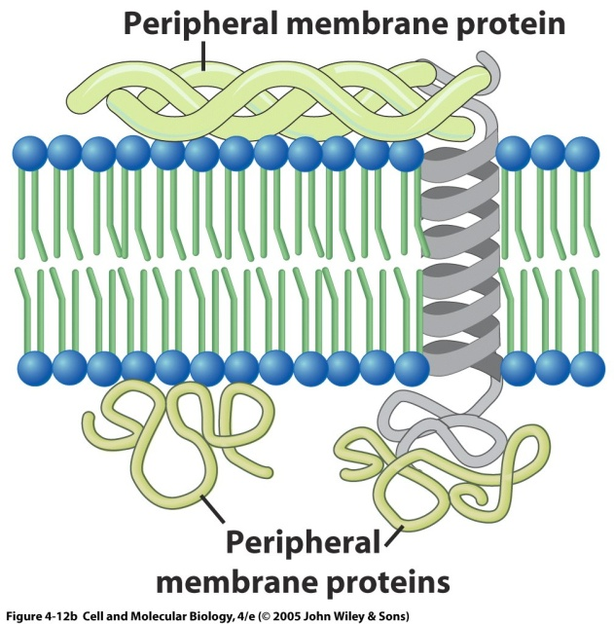
Three Classes of Membrane Proteins
Integral
(Transmembrane)
Peripheral
Lipid-anchored
Notes:
Integral membrane proteins are transmembrane proteins. Peripheral proteins are outside of the bilayer, either on the inner or outer surface of the cell. Lipid-anchored proteins are either on the outside where they are covalently linked to a lipid molecule that is situated within the bilayer or on the inside where they are bound by acyl tails.
Proteins become concentrated and some are anchored by GPI (glycosylphosphatidylinositol) on the outside.

Slide 5
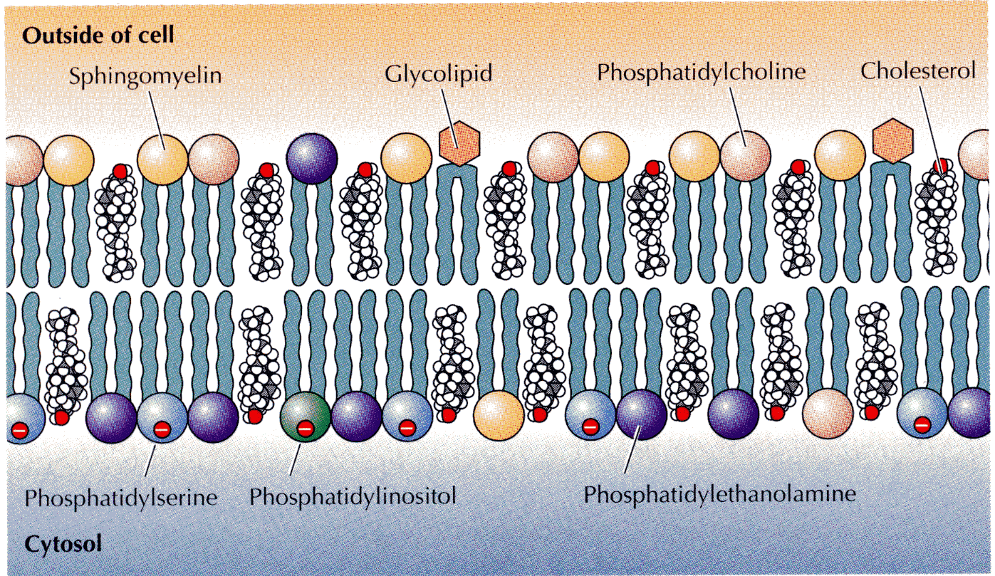
Lipid Bilayer is Asymmetrical
Notes:
Cooper 2nd Fig 12.2
Lipid components of the plasma membrane.The outer leaflet consists predominantly of phosphatidylcholine, sphingomyelin, and glycolipids, whereas the inner leaflet contains phosphatidylethanolamine, phosphatidylserine and phosphatdylinositol. Cholesterol is distributed in both leaflets. The net negative charge of the inner leaflet is indicated.
Note: Phosphatidylserine (normally confined to the inner bilayer) translocates to the outer bilayer in cells undergoing apoptosis. The presence of phosphatidylserine on the cell surface serves as a signal for neighboring cells to phagocytize the dead cell – An eat me signal.
Why the asymmetry? Appears to be due to a gene – TAT-1 that transfers PS to the inner membrane (Science 2008)
Charge difference --> electrochemical gradient which can drive cellular reactions
Some cytoplasmic enzymes require negative charged molecules for activity
Some cytoplasmic enzymes require specific phospholipids for activity
Cholesterol molecules immobilize the first few hydrocarbon groups of the phospholipid molecules. This makes the lipid bilayer less deformable and decreases its permeability to small water-soluble molecules. Without cholesterol (such as in a bacterium) a cell would need a cell wall.

Slide 6
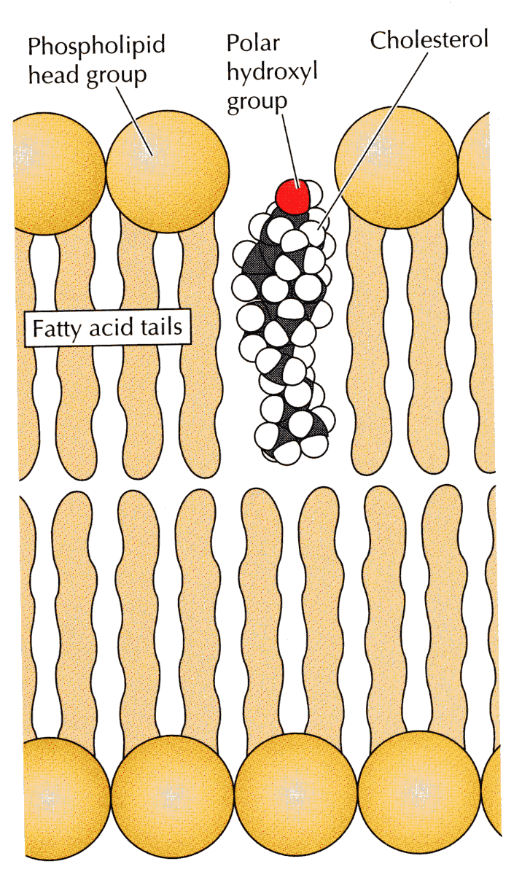
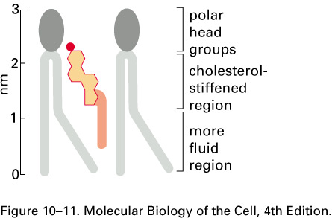
Cholesterol
Decreases the fluidity of the membrane
Notes:
The placement of cholesterol molecules interferes with the tight packing of the phospholipid tails which tends to interfere with their mobility and decrease the fluidity of the membrane. Membrane fluidity provides a perfect compromise between a rigid ordered structure and a completely fluid liquid in which components of the membrane could not be oriented – preventing any structural organization and mechanical support. Cholesterol tends to increase the durability of the membrane while decreasing the permeability. Cholesterol abolishes sharp transition temperatures (the temperature at which a change from a liquid crystalline state to a frozen crystalline gel occurs).
Longer fatty acid tails = less fluid
More saturation = less fluid
More cholesterol = less fluid
Without cholesterol (such as in a bacterium) a cell would need a cell wall.

Slide 7
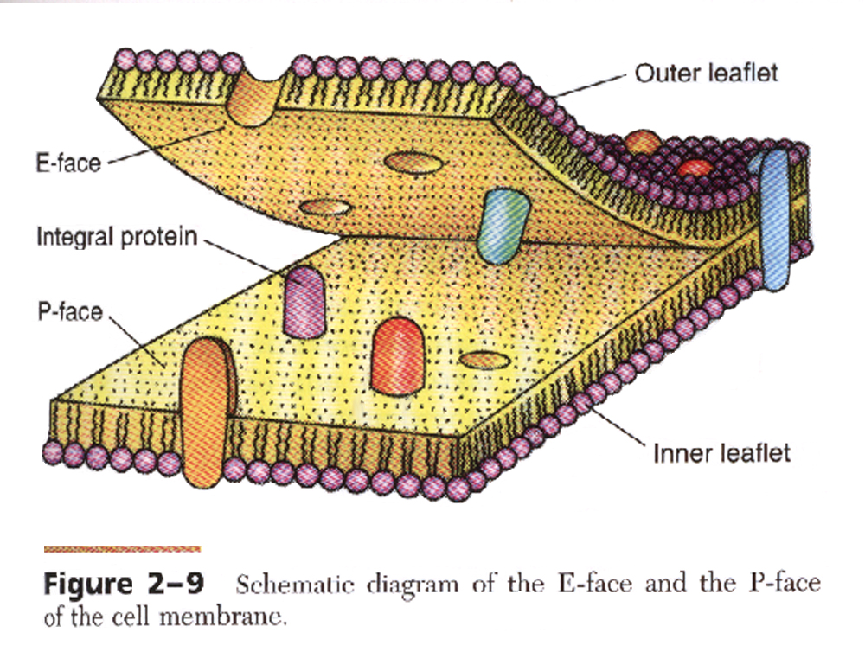

Slide 8
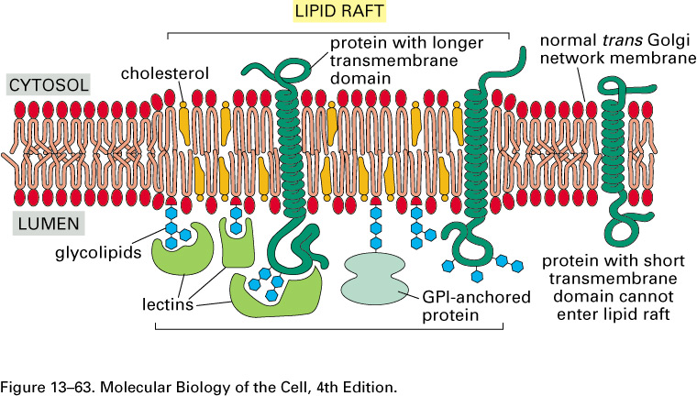
Lipid Raft
Inside
Outside
Notes:
Composed of clusters of sphingomyelin and cholesterol
Proteins become concentrated and some are anchored by GPI (glycosylphosphatidylinositol) on the outside
Serving as platforms for receptors
Facilitate signal transduction
Intracellular trafficking
Endocytosis/Exocytosis
Virus budding

Slide 9
Facilitated Diffusion
glucose
Notes:
Cooper 1st Fig 2.50 b
Carrier proteins selectively bind the small molecule to be transported and then undergo a conformational change to release the molecule on the other side of the membrane. Glucose and lactose are common substrates of the carrier proteins. Works like the locks in a canal.

Slide 10
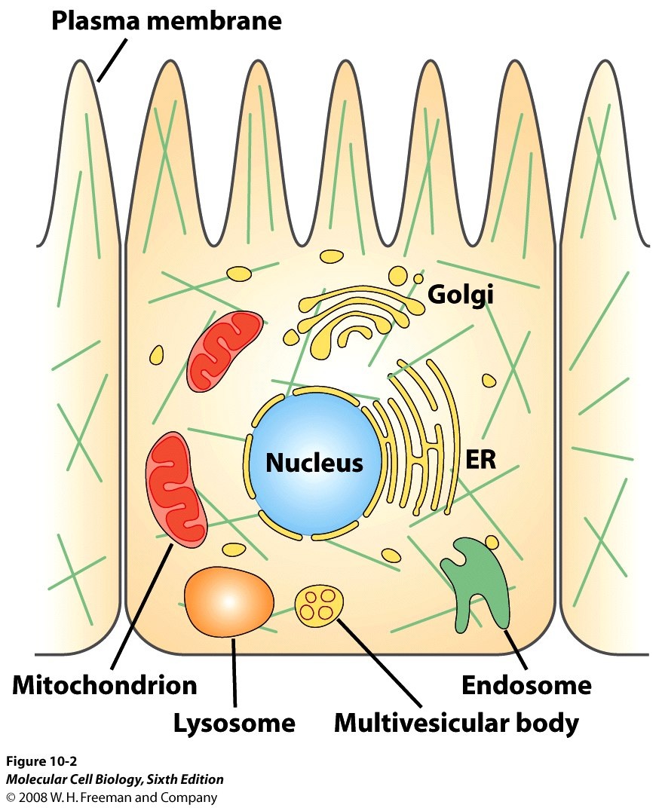
Cellular Compartments

Slide 11
Questions
What is a small region of the plasma membrane that is enriched with sphingolipids and cholesterol?
Why is flip-flop of lipids rare? How is it facilitated?
Name a cell that has a prominent glycocalyx. How does it function?
How is the membrane asymmetrical? What does asymmetry accomplish?

Slide 12
Questions
Why are red blood cells perfectly suited for studying the plasma membrane?

Slide 13
What does Transcytosis Accomplish?

Slide 14
What does this Experiment Demonstrate?

