Slide 1
MS Outlook 2007 training
Facilitator: Joanne Garcenila Calinao
Email address: garcenjv@umdnj.edu

Slide 2
We will be looking at
What’s new in Outlook 2007
Getting Started with Outlook 2007
Messages and Text
sending a message and formatting text Manipulating messages
Organizing Mail
Contacts
Calendar
Tasks and Notes

Slide 3
What’s new in Outlook 2007?

Slide 4
The Ribbon
The Ribbon is at the top of the window.
The Ribbon is to help you get things done more easily and with fewer steps.

Slide 5
Instant Search
Enter keyword
Provides a new fast way to find your information, no matter which folder it is in.

Slide 6
Getting Started with Outlook 2007

Slide 7
Opening Outlook 2007
Go to Start, All Programs, Microsoft Office then Click on Microsoft Office Outlook 2007

Slide 8
Outlook 2007 Window

Slide 9
Navigation Pane
Favorite folders
Navigation options:
•Mail – the main area where you can read,
compose, receive and send email.
•Calendar – the scheduler, or planner, where you can set and manage appointments and tasks.
•Contacts – contains your contact list where you
can store names, e‐mail addresses, and other information.
•Tasks – the task list where you can create and manage tasks
•Notes – the notes page where you can create and manage notes
•Folder List – displays all folders in a hierarchical format.
•Shortcuts – displays shortcuts.
Mail folders
Navigation

Slide 10
To-Do Bar
Located at the far right of the window, the To-Do Bar is visible wherever you happen to be working in Outlook.
The To-Do Bar is there to help you keep track of upcoming tasks and appointments.
The picture calls out a few of its key elements:
Date Navigator
Upcoming calendar appointments
A place to enter new tasks by typing
Your task list

Slide 11
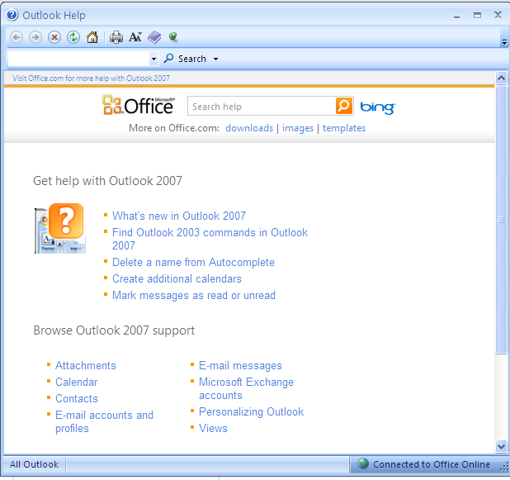
Outlook Help
Click here
Type a keyword of your topic here

Slide 12
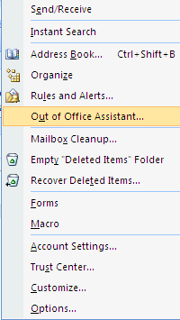
Out of office message
Click Tools
This feature sends an automatic response message while you’re out of the office.

Slide 13
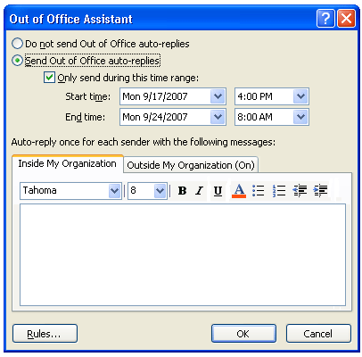
Out of office message – Out of office assistant window
Type your message on this space.
Click Ok
Select Send Out of Office auto-replies and put a check mark on the box “Only send during this time range:” Select the Start time and End time.
Next, you can type a customized message that will be used to auto reply
to messages sent by others. You can set up messages for both
inside and outside of your organization.

Slide 14
The Ribbon
Outlook commands are now more prominent, and common commands are displayed and grouped in ways that make them easy to find and use.
The Ribbon is to help you get things done more easily and with fewer steps.

Slide 15
A closer look at the Ribbon
Tabs: The Ribbon is made up of different tabs, each related to specific kinds of work you do in Outlook.
Groups: Each tab has several groups that show related items together.
Commands: A command is a button, a box to enter information, or a menu.

Slide 16
The Ribbon shows what you need
Once again, you’ll encounter the Ribbon when you take certain actions such as creating messages, calendar entries, or contacts.
The Ribbon shows tabs and commands appropriate for what you’re doing.
The tabs on the Ribbon will differ depending on the area of Outlook you’re working in.
For example:
A new message shows the Message and Options tabs.
A new appointment shows the Appointment tab.
A new contact shows the Contact tab.

Slide 17
Quick Access toolbar
Quick Access toolbar
The Quick Access
Toolbar is a small
toolbar above the
Ribbon.
It’s there to make the commands you need and use most often readily available.
Click here to customize
Quick Access Toolbar
What’s best about the Quick Access Toolbar? What’s on it is up to you.
That is, you can add your favorite commands to it with simply
This row of buttons above the Ribbon, already contains several buttons by default, but you can add new commands.

Slide 18
Lesson I: Messages and Text
Sending a message & formatting text
Compose a New message
Sending an email > To, CC, BCC (Blind Carbon Copy)
Search for email address
Attach File, Attach Item, Set message with High importance
Create Signature, Insert Signature and Choosing default signature
f. Options tab Show BCC, Request a Delivery Receipt, Request a Read Receipt

Slide 19
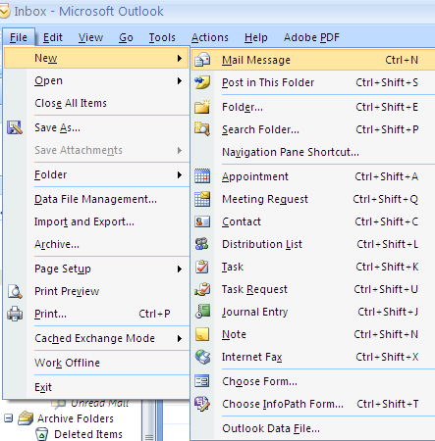
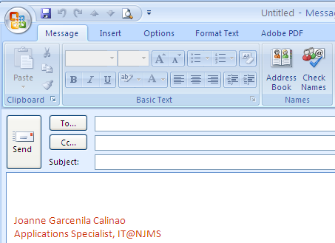
Sending a message & formatting text
a. Compose a New message, From menu bar click on File > New > Mail Message

Slide 20
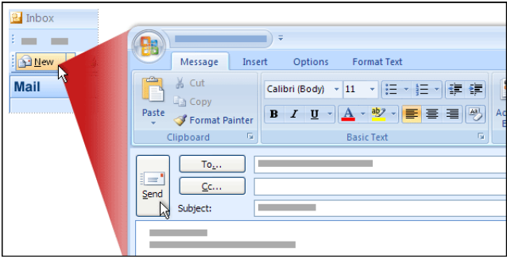
Or Select Mail on Navigation Pane> Click New
Select Mail on Navigation Pane

Slide 21
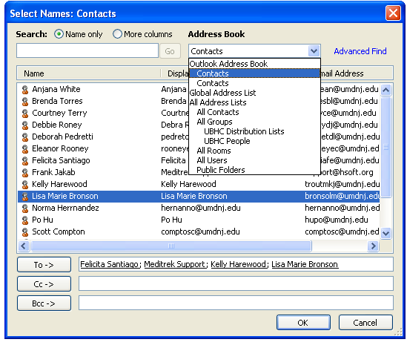
Sending a message & formatting text
b. Sending an email > To, CC, BCC (Blind Carbon Copy)
Click To button – select recipient’s email address
Click Cc – copy a person to this email
Click BCC - Blind copy a person to this email
In addition to selecting a recipients email To, you can start typing the last name of the person then Press Ctrl-K. This will also open the Address book window.
Notes:
When sending an email you can type the name of the person next to To button and the Select Name window will show. The Select Names window will show the Global Address list by default.

Slide 22
Sending a message & formatting text
c. Search for email address on Message tab select Address book

Slide 23
Sending a message & formatting text
d. Attach File , Attach Item, Set message with High importance
Attach File
Click here to Attach File
Click Insert

Slide 24
Sending a message & formatting text
d. Attach File , Attach Item, Set message with High importance
Attach Item
Click here to Attach Item
Click OK

Slide 25
Sending a message & formatting text
d. Attach File , Attach Item, Set message with High importance
Set message with High importance
Click here to set message with high importance

Slide 26
Sending a message & formatting text
e. Create Signature, Insert signature, Choosing Default Signature
How to create a signature
Click here to open Signature box window
Click New to create a new signature
Enter the name of your signature and click OK
Enter the name of your signature.
Click OK

Slide 27
Create Signature, How to Insert Signature, Choosing Default Signature
Click Signature button
If you have multiple signatures you can Select from the Signatures list
This is my default signature
You can setup a default signature so it will appear each time you create a new message.

Slide 28
Create Signature, Insert Signature, Choosing Default Signature
New Message
Replies/forward message
Click Signature button
Click here to open the Signature window
Click Ok when done with selection.

Slide 29
Lesson I: Messages and Text
f. Options tab you can Show BCC, Request a Delivery Receipt, Request a Read Receipt
add a recipient's name

Slide 30
Lesson I: Messages and Text
f. Options tab you can Show BCC, Request a Delivery Receipt and Request a Read Receipt
Click delivery receipt
Click Read receipt

Slide 31
Manipulating messages
Lesson I: Messages and Text
g. Select a message, Delete, Move to Folder
Preview a message
Opening a message and viewing it on a new window
Reply, Reply to all and Forward message, double click on message see commands on Respond group
Opening and saving an attached file
Printing a message
Adobe PDF tab – Convert to Adobe PDF

Slide 32
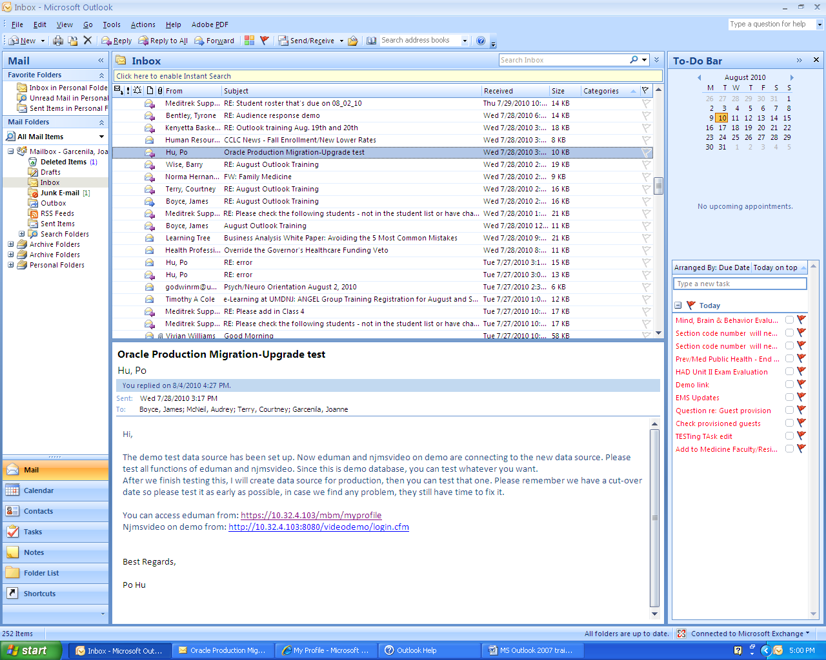
Manipulating messages
Lesson I: Messages and Text
g. Select a message, Delete, Move to Folder

Slide 33
Manipulating messages
Lesson I: Messages and Text
Select a message, Delete a message, Move to Folder
Right click on a message
Click Delete

Slide 34
Manipulating messages
Lesson I: Messages and Text
g. Select a message, Delete a message, Move to Folder
Drag and Drop the selected message to a folder on the left.

Slide 35
Manipulating messages
Lesson I: Messages and Text
h. Preview a message
Select a message
Bottom view

Slide 36
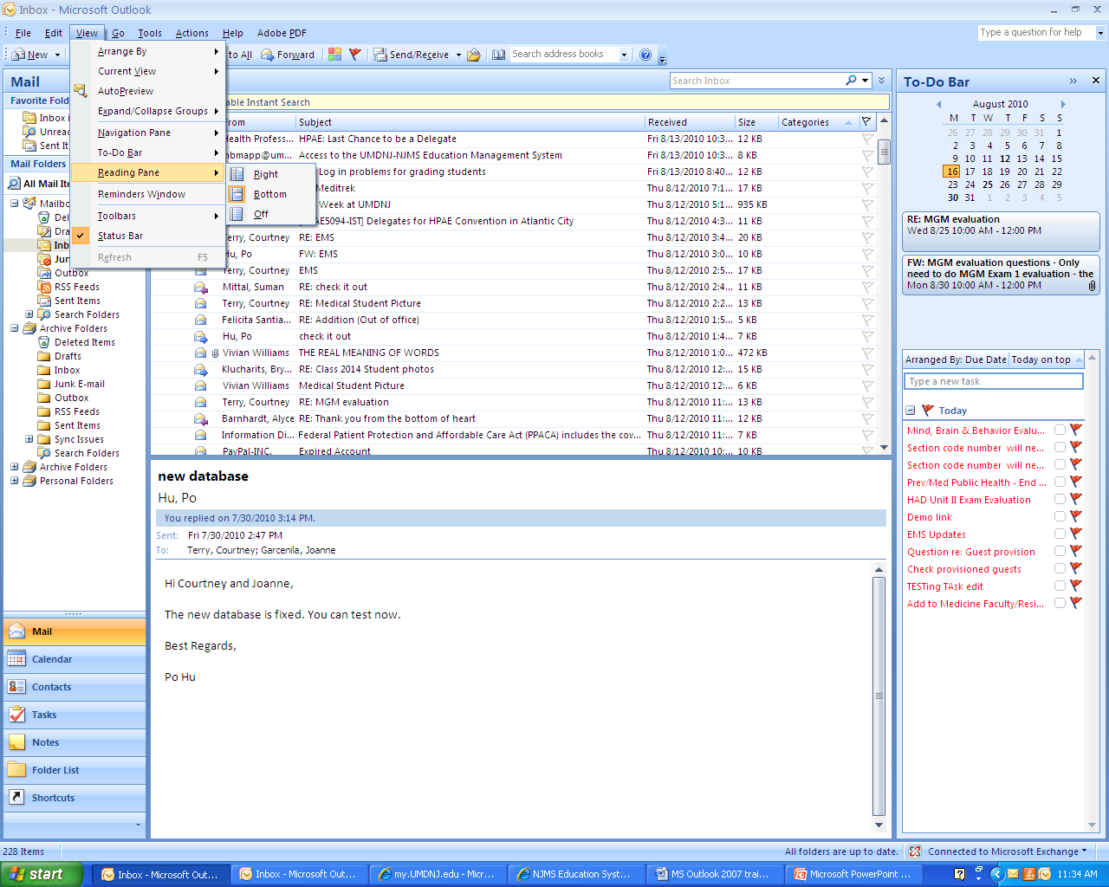
Lesson 1: Messages and Text - Preview Message
How to change the Reading pane view to Right View and Bottom View
Select reading pane

Slide 37
Manipulating messages
Lesson I: Messages and Text
i. Opening a message and viewing it on another window.
Double click on a message

Slide 38
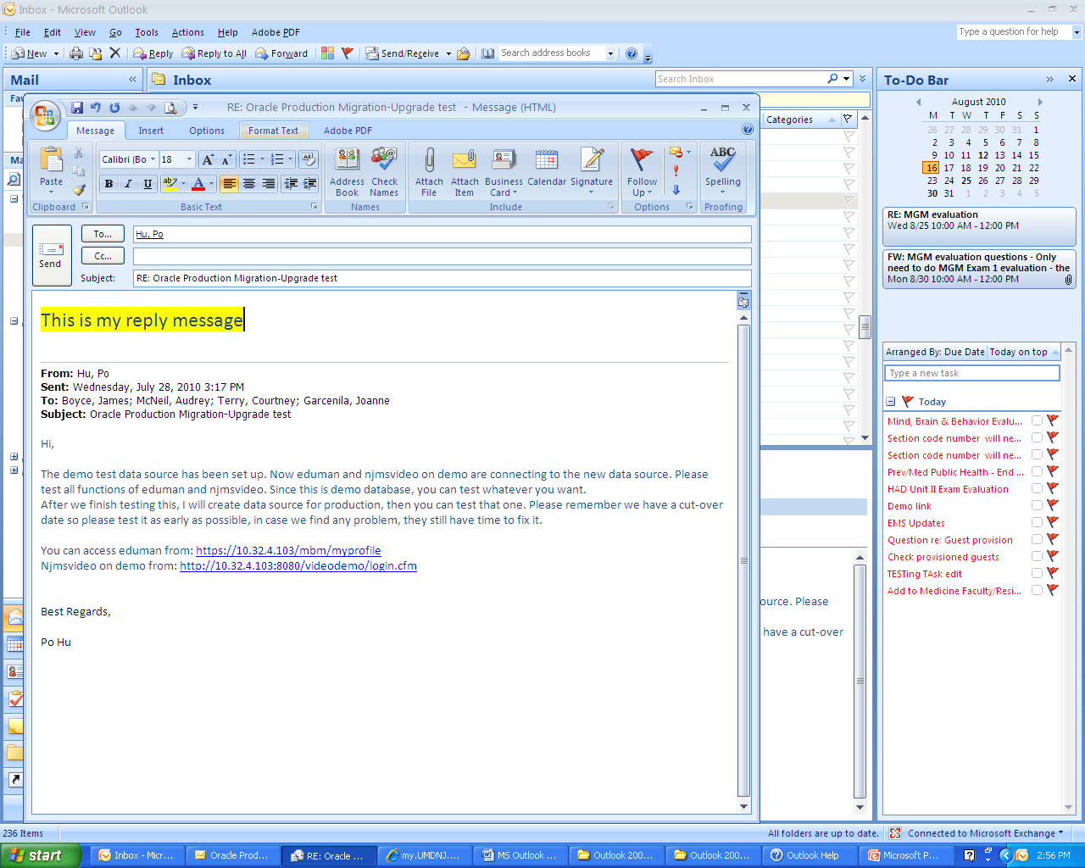
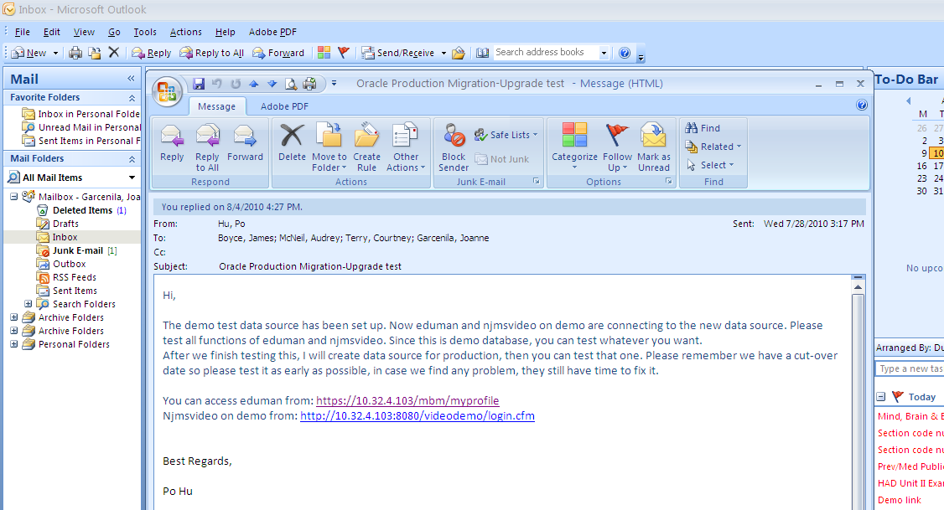
Manipulating messages
Lesson I: Messages and Text
j. Reply, Reply to all and Forward message
Click Send
Click here to send a reply

Slide 39
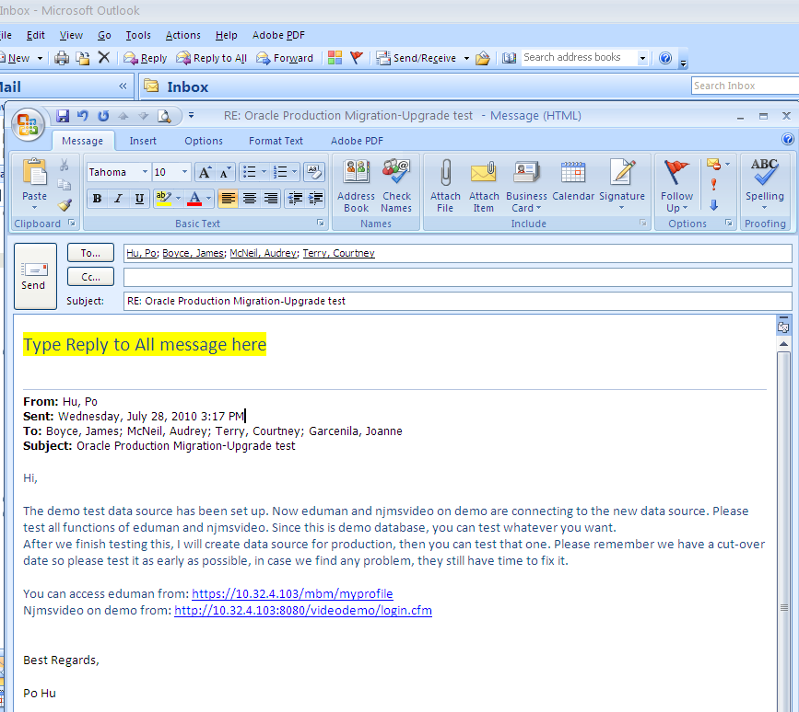
Manipulating messages
Lesson I: Messages and Text
j. Reply, Reply to all and Forward message
Click Reply to All
Click Send

Slide 40
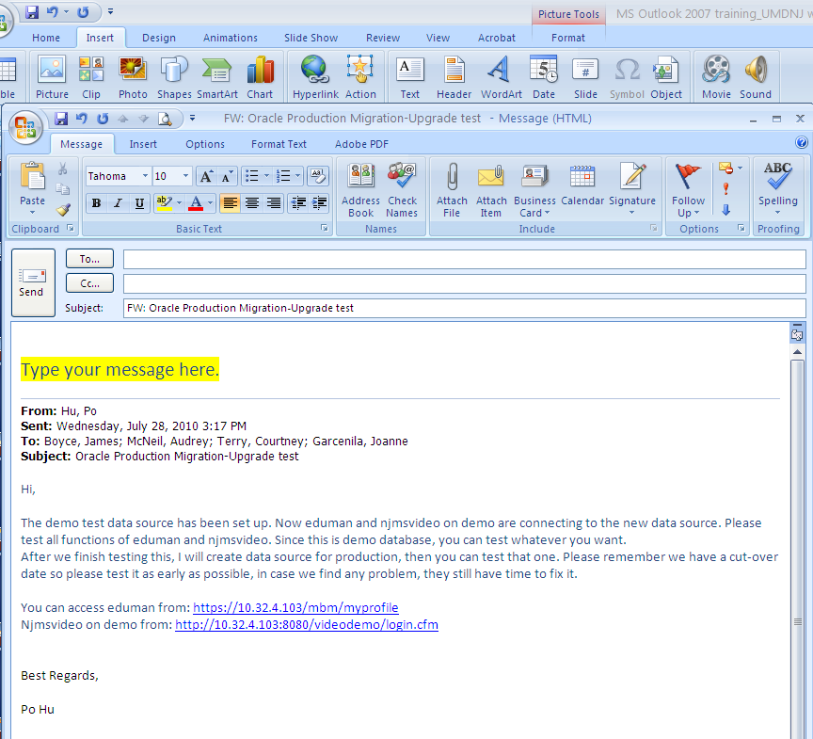
Manipulating messages
Lesson I: Messages and Text
Click Send
K. Reply, Reply to all and Forward message
Click Forward button here
Enter or look for the email address who you like to forward this message to

Slide 41
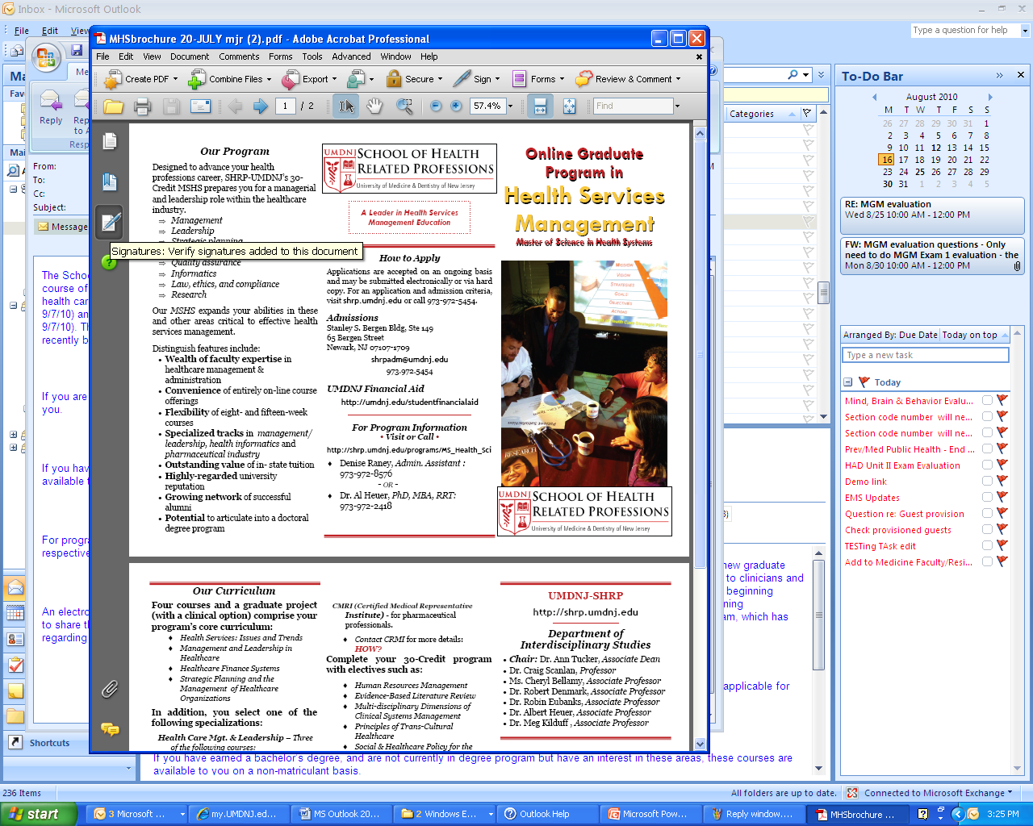
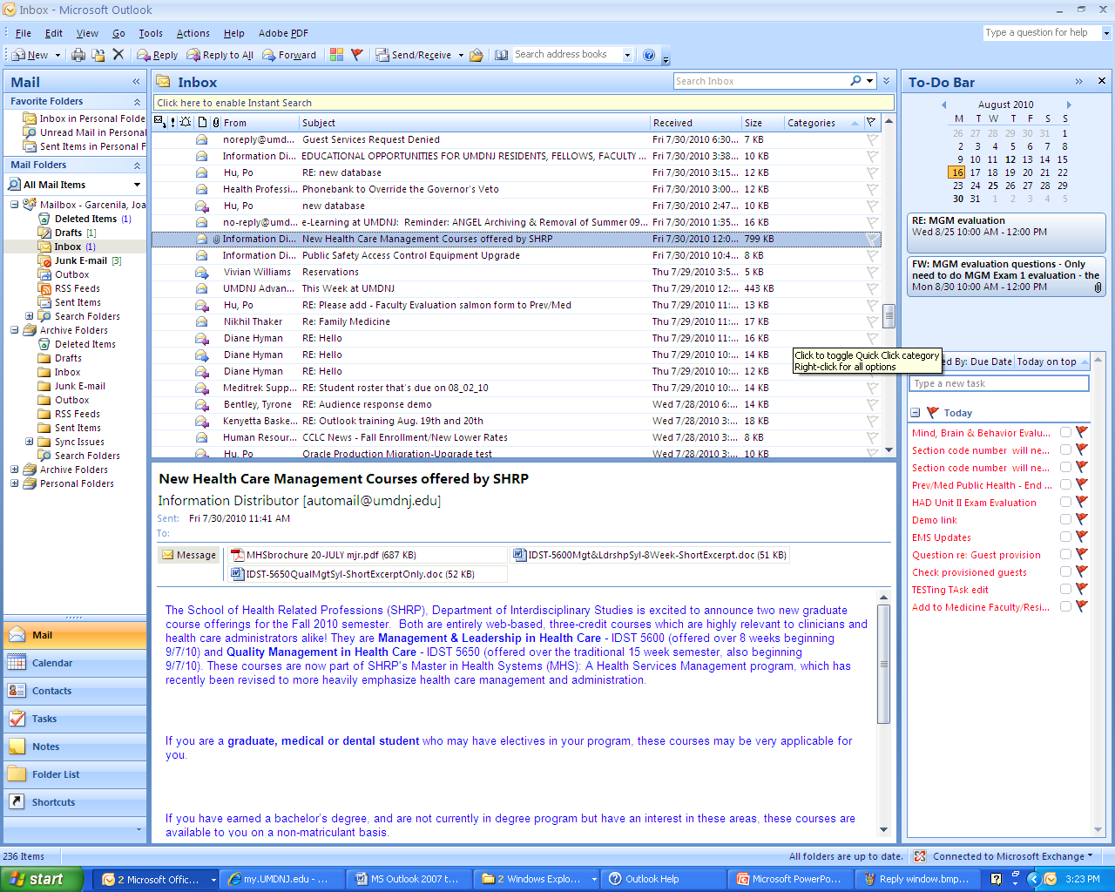
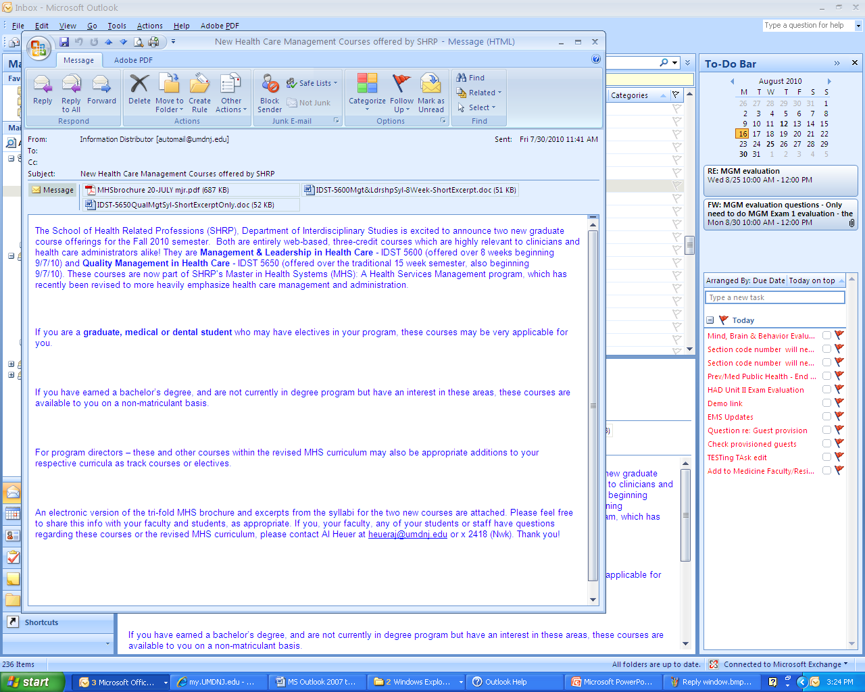
Manipulating messages
Lesson I: Messages and Text
Click File > Save As
Double click on this message with attachment.
k. Opening and saving an attached file
Double click on this attached PDF file

Slide 42
Manipulating messages
Lesson I: Messages and Text
Click print button or File > Print
Double click on this message with attachment.
k. Opening and printing the attached file
Double click on this attached PDF file

Slide 43
Manipulating messages
Lesson I: Messages and Text
l. Printing an email message
Click the print button
There are different ways to print a message and this is one of them. You can also print by clicking the Office button > Print. I’ll show you two ways to do it on the next slide.

Slide 44
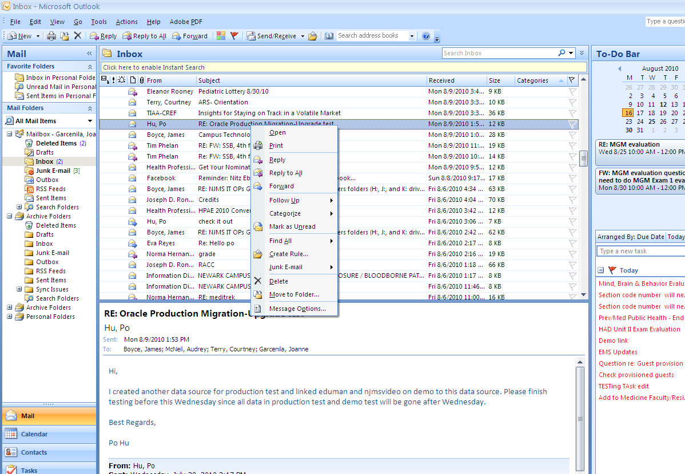
Shortcut buttons when you right click on a message

Slide 45
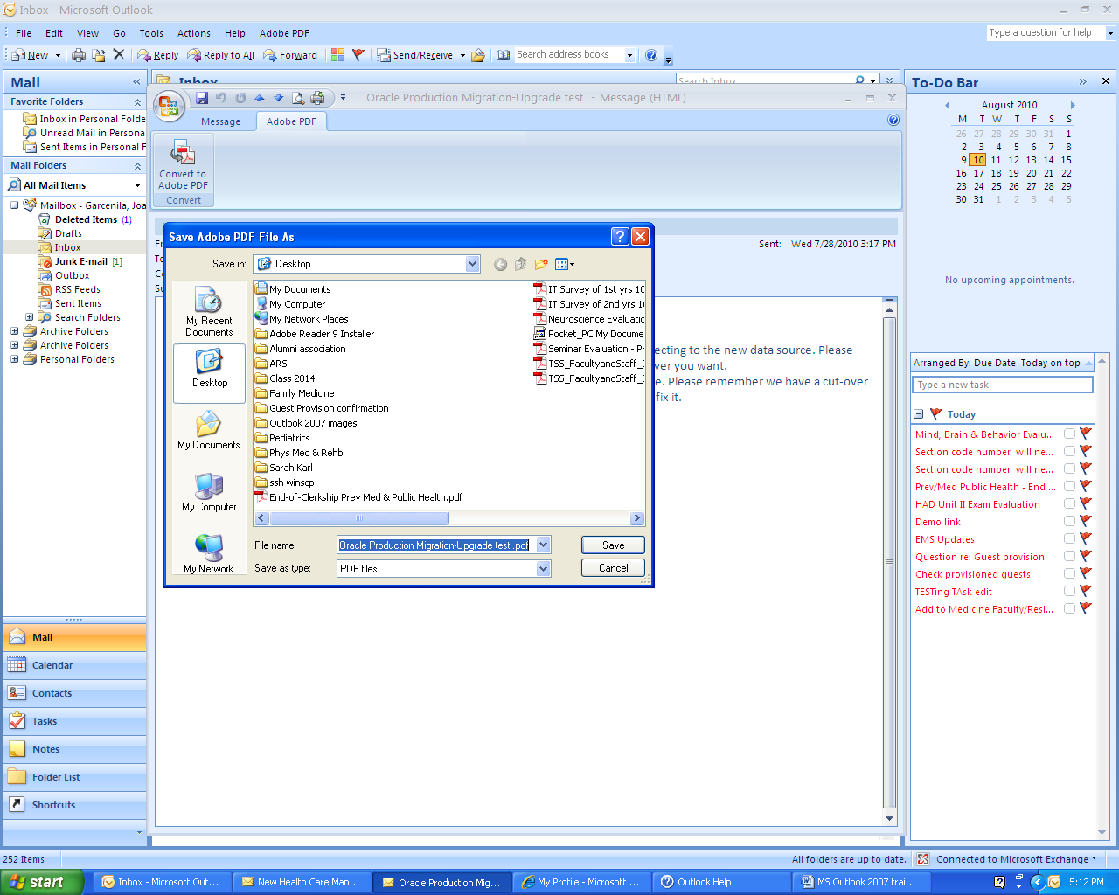
Manipulating messages
Lesson I: Messages and Text
m. Convert an email message to Adobe PDF file
Click Adobe PDF tab
Save

Slide 46
Lesson I: Messages and Text
Organizing Mail
n. Searching for a message - Type a keyword in Search Inbox box
o. Creating a new mail folder - Right click on Mail navigation Pane, Select New Folder
p. Moving item from Outlook to a different folder or other location
q. Delete mail folder - Right click on a folder (ex. Test New Folder), Select Delete “Test New Folder”
r. Delete a message - Right click on the message, Select Delete
s. Recover a deleted message – In the folder from where you deleted the item, or select Deleted Items folder, click Recover Deleted Items on the Tools menu.
t. Marking a message as unread – Right click on message, select Mark as Unread

Slide 47
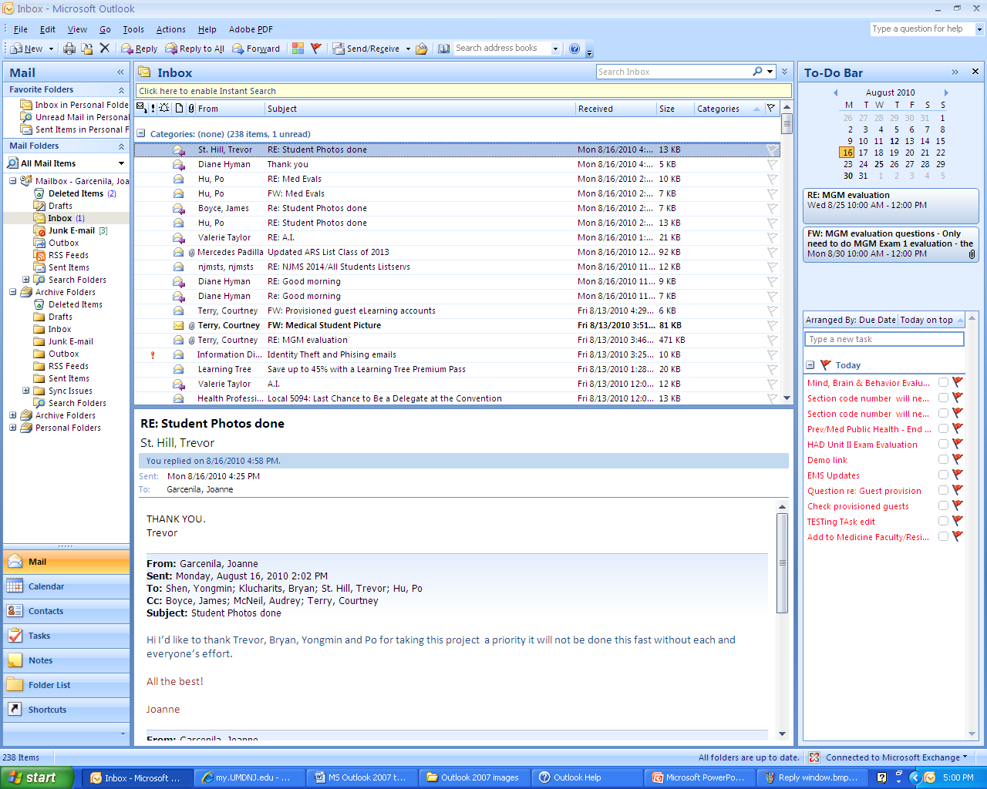
Lesson I: Messages and Text
Organizing Mail
n. Searching for a message
Type a keyword
Keyword can be subject, name of sender and Date received.

Slide 48
Lesson I: Messages and Text
Organizing Mail
o. Creating a new mail folder
Click Ok
Right click on a folder where you like the new folder to be located , Select New Folder

Slide 49
Lesson I: Messages and Text
Organizing Mail
p. Moving item from Outlook to a different folder or other location
Item refers to email message or attachment.
Use Drag and Drop feature
Select the item you want to move.
Drag to the destination folder, and then release the mouse button.
Also, you can drag and drop a file from your desktop or other location (ex. K drive) as attachment to a New Message.

Slide 50
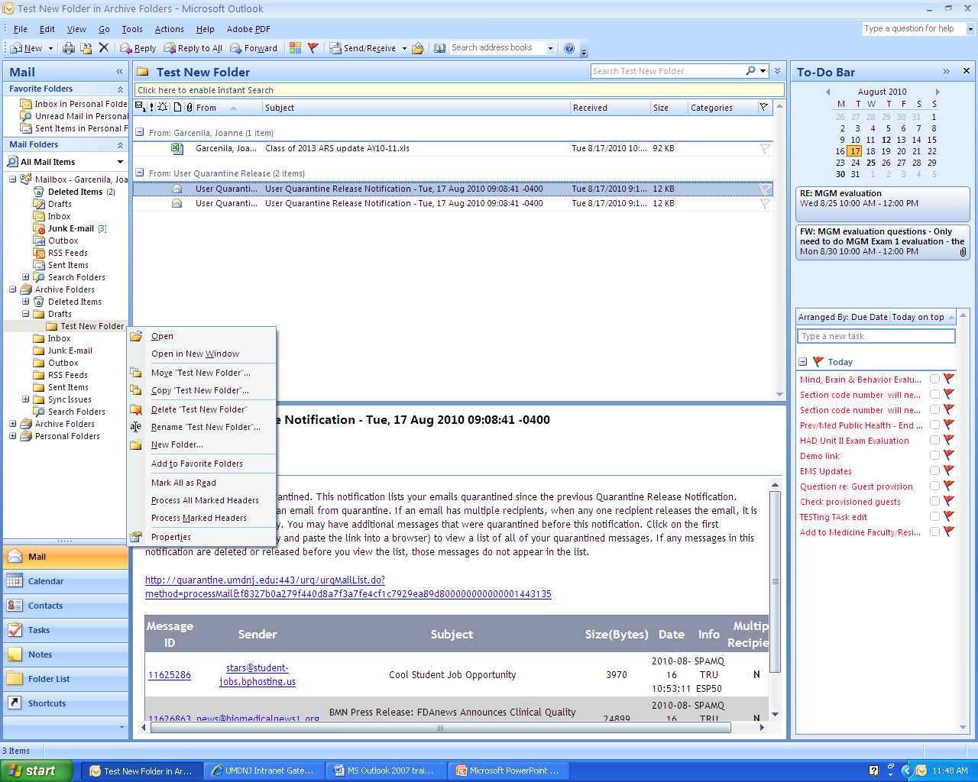
Lesson I: Messages and Text
Organizing Mail
q. Delete mail folder - Right click on a folder (ex. Test New Folder), Select Delete “Test New Folder”

Slide 51
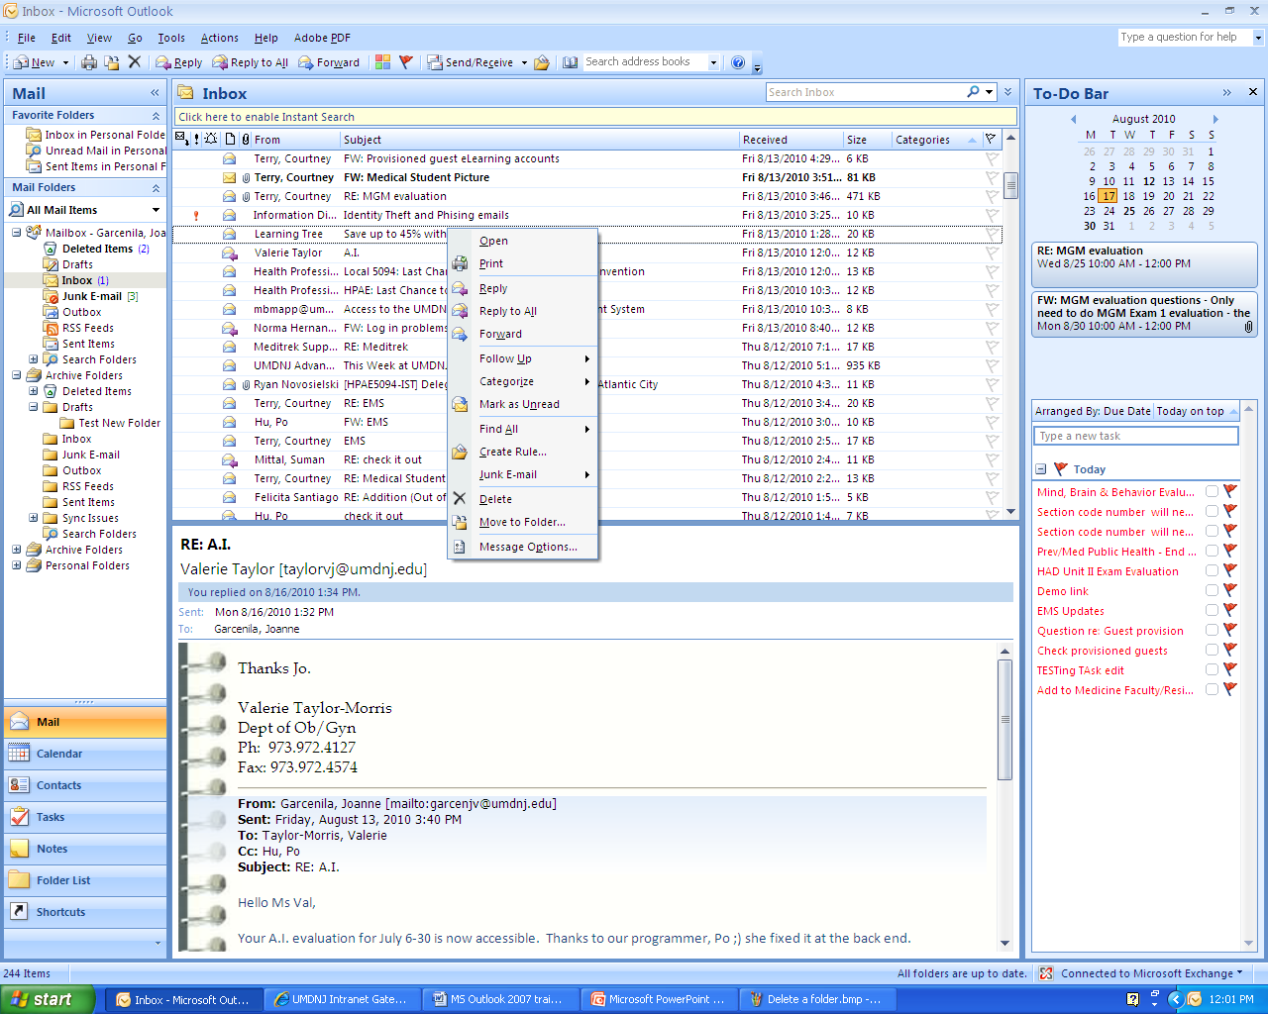
Lesson I: Messages and Text
Organizing Mail
r. Delete a message
Select Delete

Slide 52
Lesson I: Messages and Text
Organizing Mail
s. Recover a deleted message
Microsoft Office Outlook 2007 provides a way to recover items after you delete them permanently, even after you empty the Deleted Items folder.
In the folder from where you deleted the item, or in the Deleted Items folder, click Recover Deleted Items on the Tools menu.
Take note: You have two weeks to recover your deleted message.

Slide 53
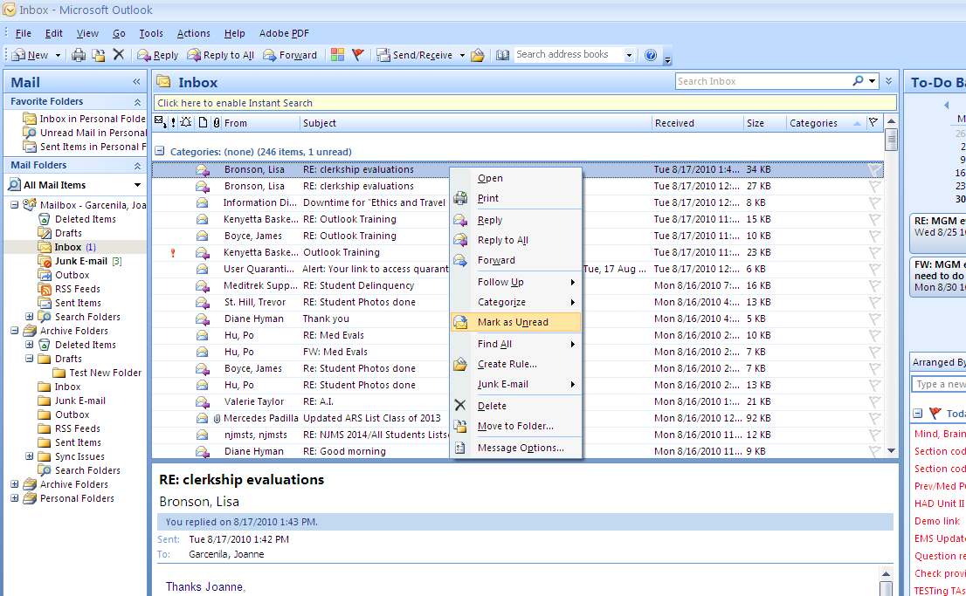
Lesson I: Messages and Text
Organizing Mail
t. Marking a message as unread
select Mark as Unread

Slide 54
Lesson II: Contacts
a. Adding a new contact
b. Adding the sender of a message to contacts
c. Deleting a contact
d. Sort Contacts –Click small icons: Sort by From, Subject, Date Received, Importance, and Size
Find Contacts using Address book
Select Contacts on Nav Pane, Click dropdown arrow next to New , select Distribution list
g. Add new email address to distribution list
h. Remove an email address from a distribution list
i. Sending an email to distribution list

Slide 55
Lesson II: Contacts
Adding a new contact
You can also add a new contact from the Mail navigation and by pressing shortcut keys. I’ll show you on the next slide.
Click New
Click Save

Slide 56
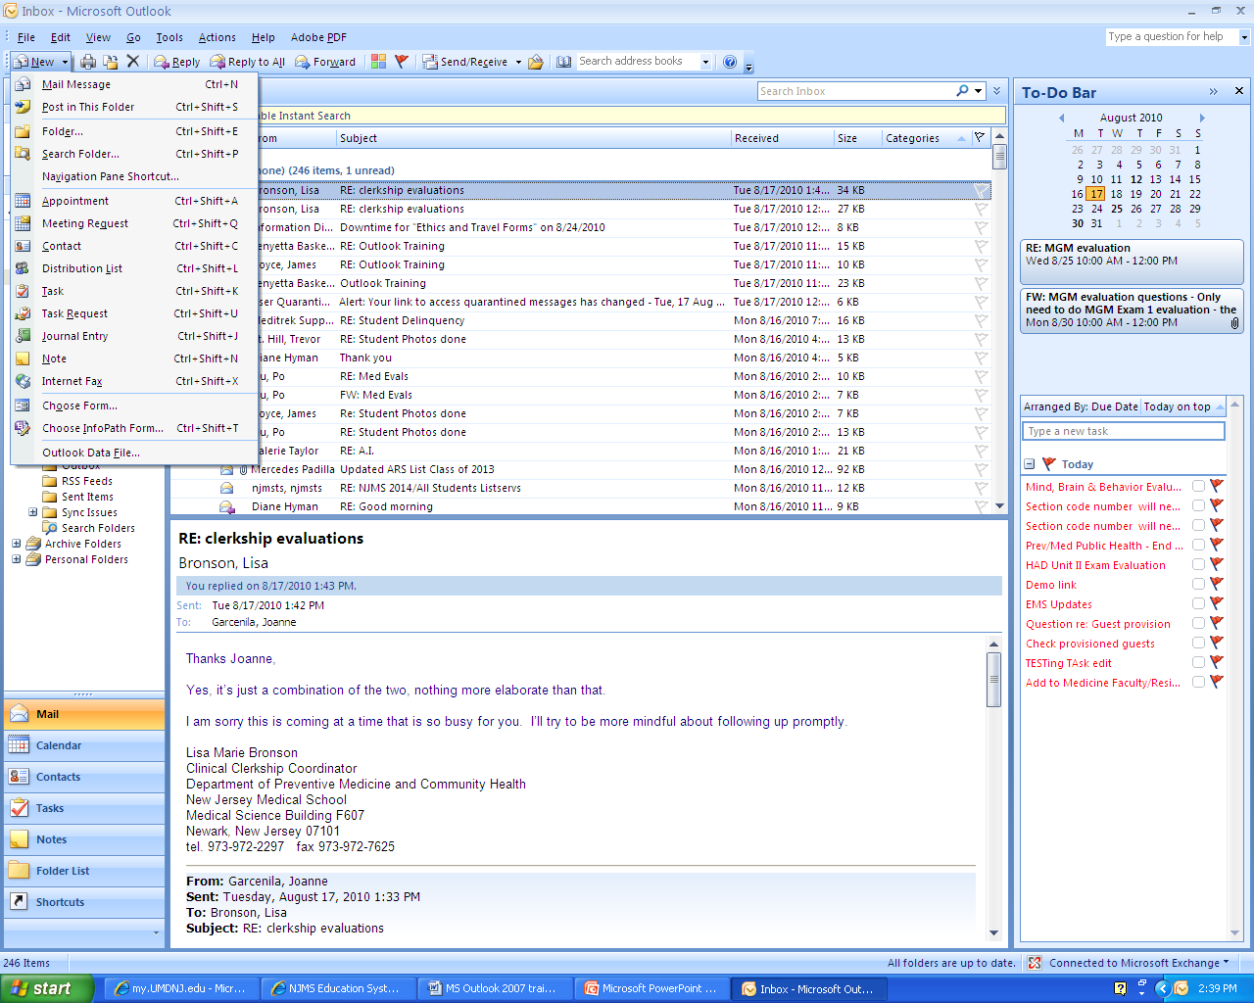
Or from Mail navigation to add a new contact
Click New
Select Contacts
Or use shortcut by Pressing Ctrl-Shift-C anywhere you’re in outlook.

Slide 57
Lesson II: Contacts
Adding the sender of a message to contacts
Let’s say a message is now selected and it’s open.
Right click on sender’s name
Select Add to Outlook Contacts

Slide 58
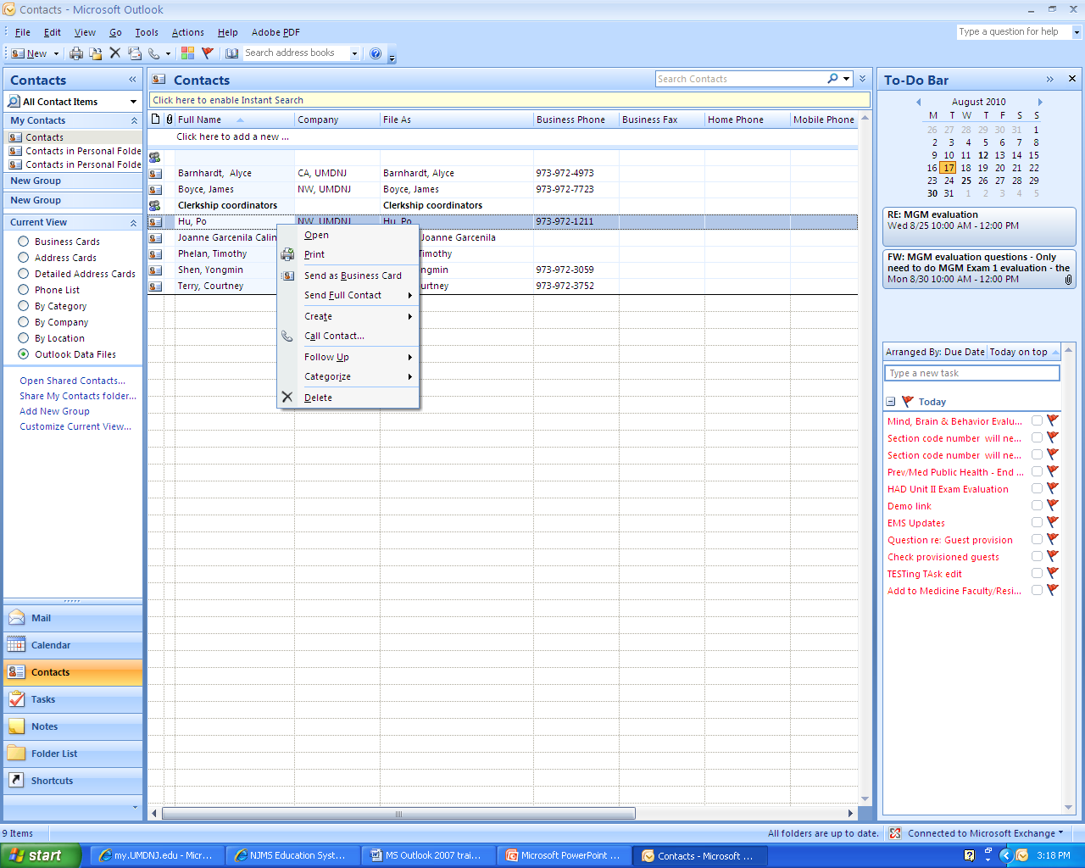
Lesson II: Contacts
c. Deleting a contact
Or click this Delete button
Select Delete
Select Contacts from the navigation pane

Slide 59
Lesson II: Contacts
Sort Contacts
Simply click on how you would like it sorted, for example Full name.

Slide 60
Lesson II: Contacts
e. Find Contacts using Address book
Type the person’s name on this box
Or Press Ctrl-Shift-B to open the address book anywhere in Outlook.

Slide 61
Lesson II: Contacts
Creating a new distribution list
A distribution list is a collection of contacts (contact: Person, inside or outside of your organization.) It provides an easy way to send e-mail messages to a group of people. For example, if you frequently send messages to the marketing team, you can create a distribution list — called "Marketing Team"
Select Distribution List
Add New Member to Distribution list are people from your contact list.
Select Members will open the address book window

Slide 62
Lesson II: Contacts
Add new email address to an existing distribution list
Click Add New

Slide 63
Lesson II: Contacts
h. Remove an email address from a distribution list
Click Remove

Slide 64
Lesson II: Contacts
i. Sending an email to distribution list
Select Email

Slide 65
Lesson III: Calendar
a. Explore Outlook Calendar
b. Change view of calendar – View menu select Current view
c. Schedule or add an appointment - Click Calendar Navigation Pane click New
d. Edit appointment – Double click on the appointment
e. Delete appointment – Right click on appointment, select Delete
f. Sharing a calendar – Calendar Navigation Pane on the left click Share my calendar

Slide 66
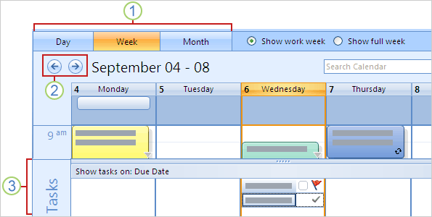
1. Using Calendar
Explore Outlook Calendar
The new design of the calendar in Outlook 2007 you'll notice that it's easier to see what's what.
The picture shows some examples:
Bigger buttons make it easier to quickly switch between daily, weekly, and monthly calendar views.
Back and Forward buttons let you quickly go to the next day, week, or month in the calendar.
Tasks - You can use this area to track your accomplishments: Completed items on this list appear crossed out and "stick" to the day; tasks not marked as complete will automatically be carried over to the next day, until you complete them.

Slide 67
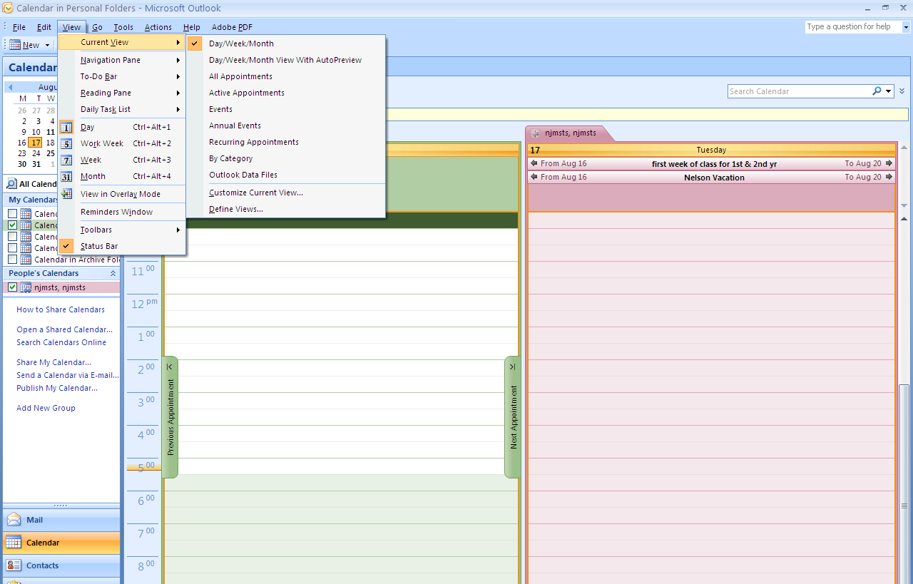
Lesson III: Calendar
b. Change view of calendar – View menu select Current view

Slide 68
Calendar View

Slide 69
Two calendar views
shared calendar
Personal calendar

Slide 70
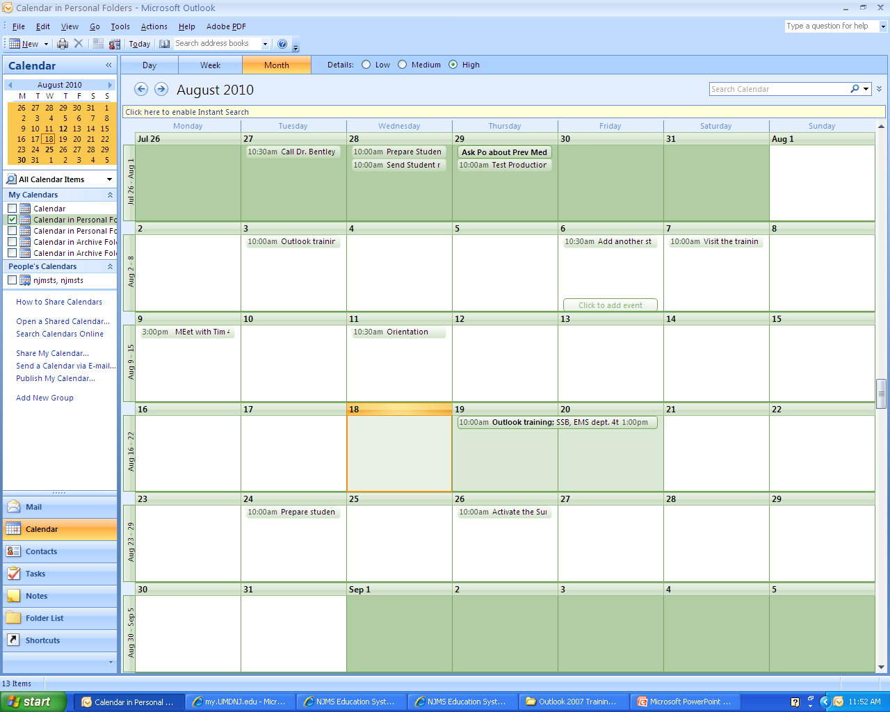
Lesson III: Calendar
c. Schedule or add an appointment
Day/Week/Month current view
Click Save
Double click on the day you like to add or schedule an appointment
Click Calendar on Navigation Pane

Slide 71
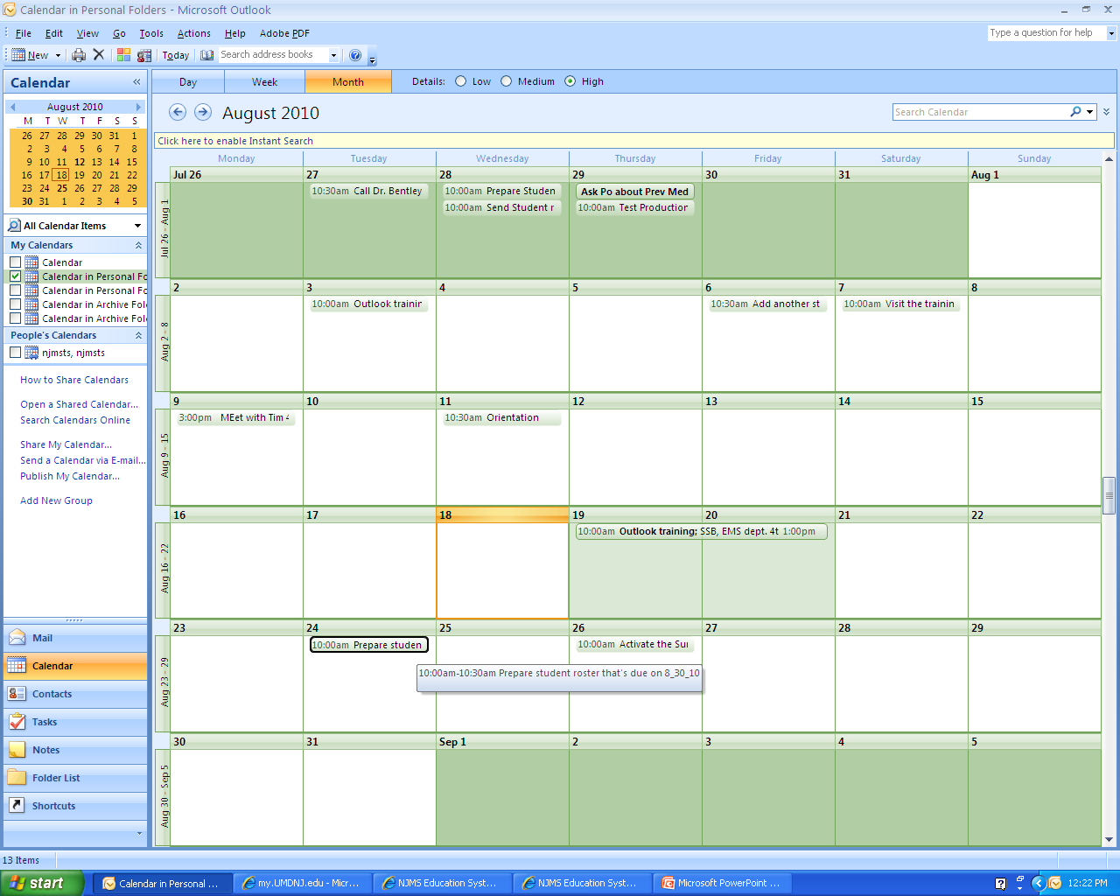
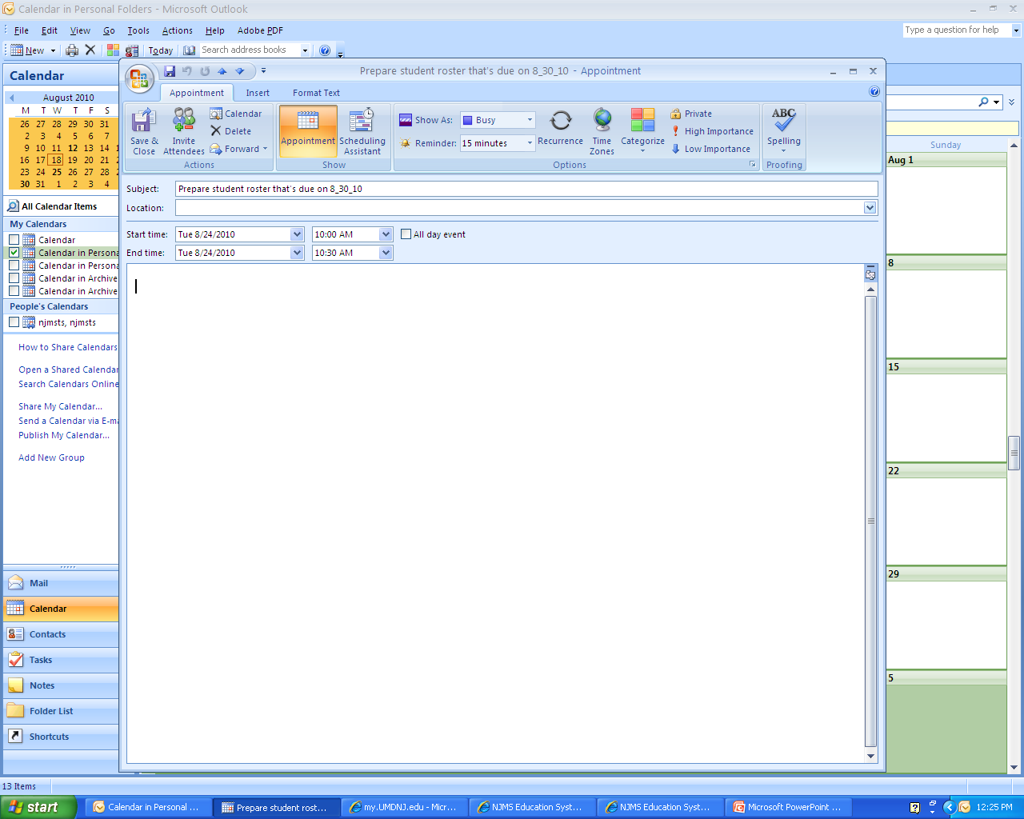
Lesson III: Calendar
d. Edit an appointment
Click Save
Double click the appointment

Slide 72
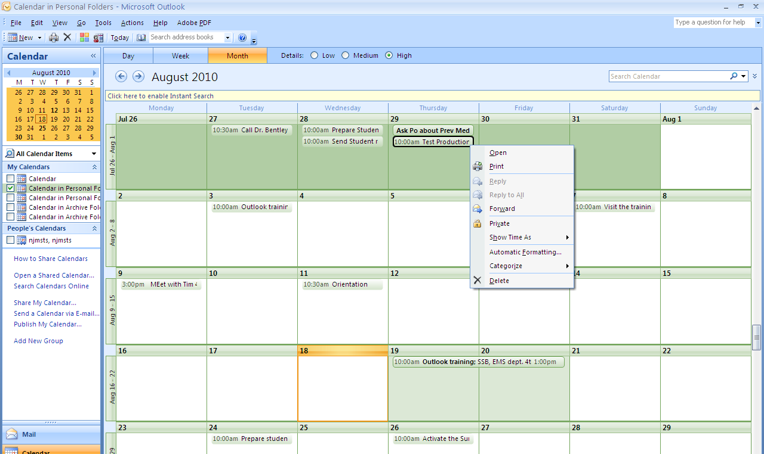
Lesson III: Calendar
e. Delete appointment
Select Delete

Slide 73
Lesson III: Calendar
f. Sharing a calendar
Click Send
Click Share my calendar

Slide 74
Lesson IV: Managing Tasks and Notes
Create a task
Edit and Update a Task – Double click on task and make your edit, Save & Close
Create a note – Select Notes on Navigation Pane, Click New
Edit note- Select Notes on Navigation Pane, Double click on the note you like to edit.
Display a note on the Desktop-Drag and drop to desktop
Print a note- Right click on a note, Print

Slide 75
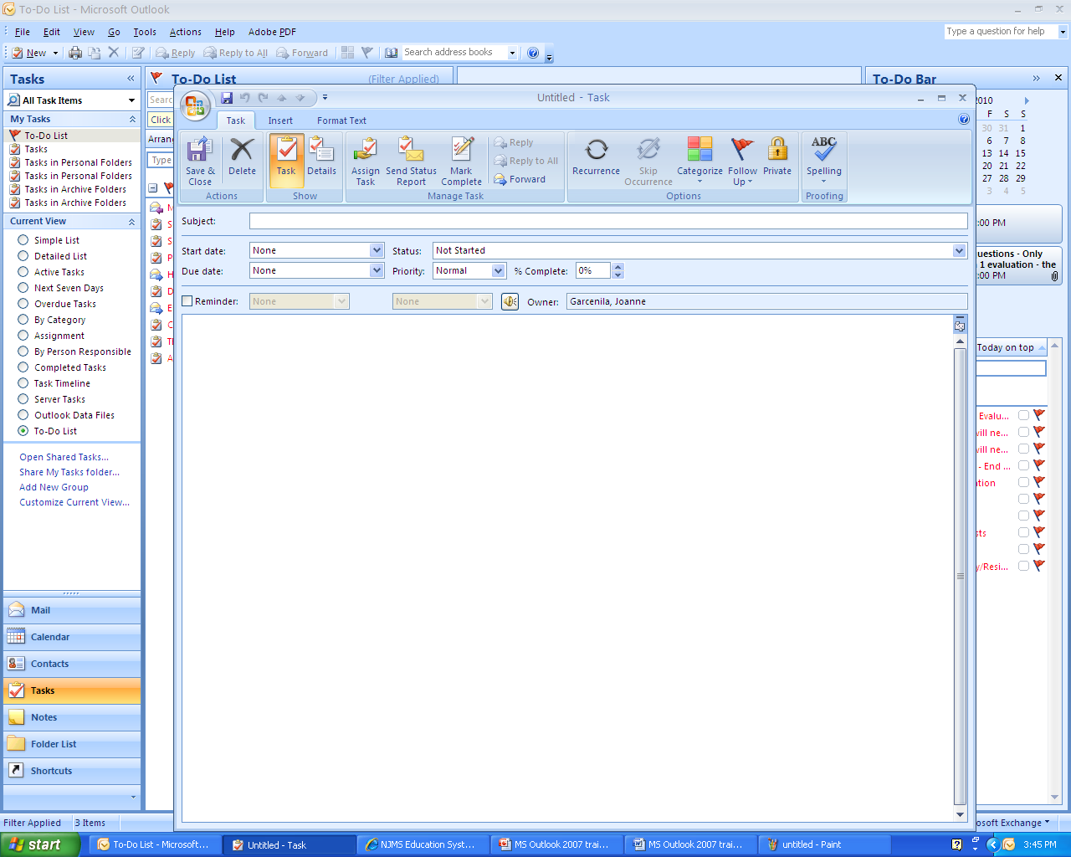
Lesson IV: Managing Tasks and Notes
Click Save
Create a task
You can create a task anywhere in Outlook by pressing Ctrl-Shift-K or
Click New
Click dropdown next to New
Select Task
Select Task on Navigation Pane

Slide 76
Lesson IV: Managing Tasks and Notes
Edit and Update a Task
Click Save
Double click on a task

Slide 77
Lesson IV: Managing Tasks and Notes
c. Create a Note
You can create a Note anywhere in Outlook by pressing Ctrl-Shift-N or
Click New
Click dropdown next to New
Select Note

Slide 78
Lesson IV: Managing Tasks and Notes
Edit note- Select Notes on Navigation Pane, Double click on the note you like to edit.
Double click on the note when it’s open just type your changes and X.

Slide 79
Lesson IV: Managing Tasks and Notes
e. Display a note on the Desktop
Drag and drop a note to desktop

Slide 80
Lesson IV: Managing Tasks and Notes
f. Print a note- Right click on a note > Print

Slide 81
Additional Information- Advanced

Slide 82
Rules and Alerts
Select Tools
Select Rules and Alerts
Click New Rule

Slide 83
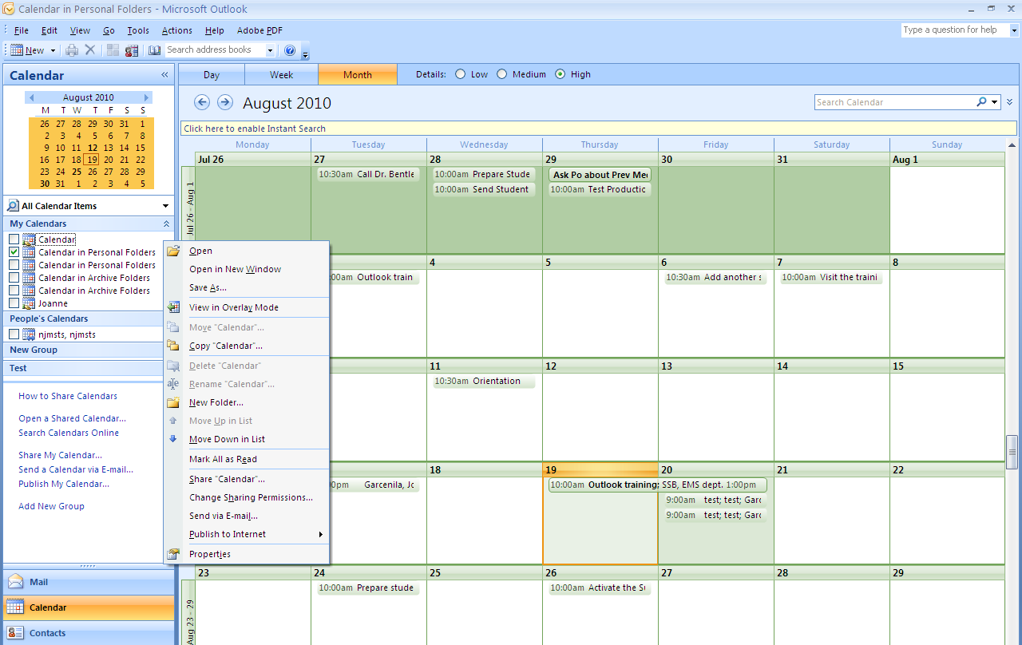
Add or Remove Sharing Permissions

Slide 84
Create, View or Delete a group schedule
In Calendar, on the Actions menu, click View Group Schedules.
Do one of the following:
Create a group schedule
In the Group Schedules dialog box, click New.
Type a name for the new group schedule, and then click OK.
Click Add Others, and then click either Add from Address Book or Add Public Folder.
Select the names or the public folders that you want to add, and then click OK.
Click Save and close.
View a group schedule
Select the group schedule that you want to view, and then click Open.
Delete a group schedule
Select the group schedule that you want to delete, and then click Delete.

Slide 85
Thank you!

