Slide 1
DNA damage repair; good or bad for
cancer development and treatment
Katsunori Sugimoto
nori.sugimoto@rutgers.edu

Slide 4
Cancer
Abnormalities in
Proliferation
Contact inhibition
Energy efficiency glycolysis but not on TCA cycle
Immune response
-------- accumulations of mutations in various genes

Slide 5
How cancer develops
Accumulation of mutations

Slide 6
There is no single “mutated gene” that causes cancer.
BRCA1 and BRCA2
Around 5% of cases of breast and ovarian cancers can be explained by the woman having inherited a faulty copy of BRCA1 and BRCA2
Explains 5% one of all breast cancers and 10% of ovarian cancers
􏰀 Their chance of developing these cancers is higher than average but unless further mutations occur over time in a number of other ‘cancer protection’ genes in breast and/or ovarian cells, those cells will never become cancerous.
90 % --- non inherited
A woman’s lifetime risk of developing breast and/or ovarian cancer is greatly increased if she inherits a harmful mutation in BRCA1 or BRCA2.
10% women will develop breast cancer during life time
50% if BRCA1 or BRCA2 is mutated
1% women will develop ovarian cancer during life time
40 % if BRCA1 or 15% if BRCA2 is mutated
Not “100 %”
There are many mutations which we do not know whether harmful or beneficial.

Slide 7
You may be luckier, men.
If a man has inherited a faulty copy of the BRCA1 or BRCA2 gene, his risk for developing prostate cancer is increased.
If a man has inherited a faulty copy of the BRCA2 gene (but not the BRCA1 gene) he has a slightly increased risk of developing breast cancer.

Slide 8
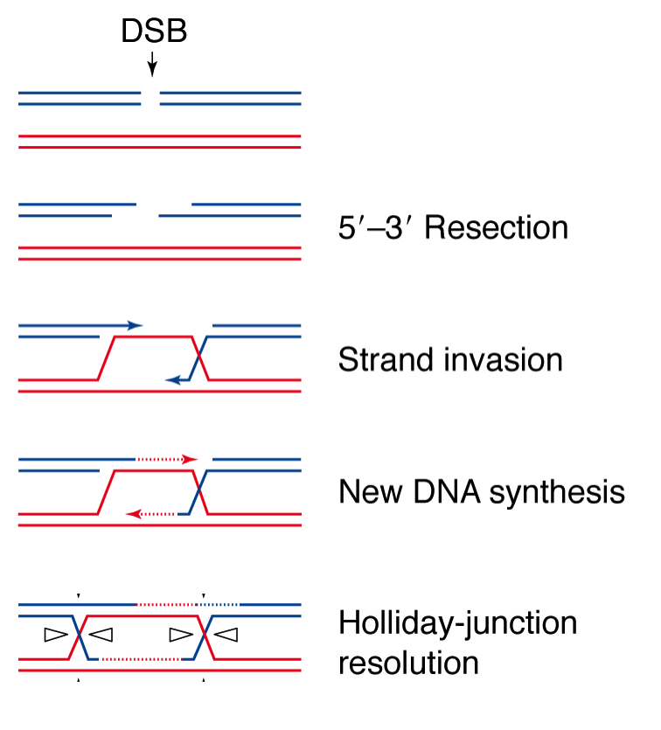
Roles of BRCA1 and BRCA2 in Homologous recombination
BRCA1
ssDNA generation by several nuclease activities
BRCA1
Rad51-covered ssDNA
BRCA2
DNA polymerase

Slide 9
DNA double-strand break (DSB)
One major damage to activate checkpoint signaling is
DNA double-strand break (DSB)
, if not repaired efficiently.
Notes:
We consider that DSB of DNA is one major cause to activate the checkpoint pathway.

Slide 10
DSBs are recognized by the Mre11 complex. The Mre11 complex acts as 3’-5’ exonuclease and makes cohesive ends.
BRCA1
Mre11-Rad50-Nbs1 (MRN)
Mre11-Rad50-Xrs2 (MRX)
Exonulease
ATPase,
DNA binding, related to SMC proteins
Notes:
During a repair process, DSBs are recognized by the Mre11 complex. The Mre11 complex consists with Mre11, Rad50 and Xrs2 in budding yeast, or alternatively Nbs1 in human.

Slide 11
Generating 3’-ended ssDNA tail
for homologous recombination
MRX and Sae2 (CtIP) act at an early step, whereas
Sgs1 (BLM) helicase, Dna2 nuclease and Exo1 exonuclease work later.
Exo1
CtIP
BRCA1
3’
BLM
Dna2
MRN
Notes:
The mre11 complex and exo1 act as exonuclease, and control DSB repair together.

Slide 12
DNA ends after DSB induction are not always clean.
Clean DNA ends
DNA adducts or modifications
Ku bound DNA ends

Slide 13
Generating 3’-ended ssDNA tail at blocked DNA ends
MRX and Sae2 (CtIP) act at an early step, whereas
Sgs1 (BLM) helicase, Dna2 nuclease and Exo1 exonuclease work later.
CtIP
Mre11-Rad50-Nbs1
Notes:
The mre11 complex and exo1 act as exonuclease, and control DSB repair together.

Slide 14
MRN and CTIP/Sae2 collaborate to induce a nick near the DNA end.
MRN
CtIP
Notes:
The mre11 complex and exo1 act as exonuclease, and control DSB repair together.

Slide 15
MRN acts as a 3’-5’ nuclease and Exo1 degrades from 5’ to 3’ direction.
Exo1
CtIP
5’
3’
MRN
Notes:
The mre11 complex and exo1 act as exonuclease, and control DSB repair together.

Slide 16
Single stranded DNA is covered with RPA.
Replication protein A (RPA)
Notes:
Single stranded DNA binding protein, replication protein A (RPA).

Slide 17
Single stranded DNA is covered with RPA.
BRCA2
Rad51 (RecA)
Notes:
Single stranded DNA binding protein, replication protein A (RPA).

Slide 18
Single stranded DNA is covered with RPA.
BRCA2
Rad51 (RecA)
Notes:
Single stranded DNA binding protein, replication protein A (RPA).

Slide 19
5’
3’
5’

Slide 20
5’
3’
5’
DNA synthesis by DNA polymerase
DNA synthesis by DNA polymerase
Branch migration

Slide 21
Resolvase
Mus81-Eme1 nuclease
5’
3’
5’
DNA synthesis

Slide 22
DSBs are recognized by the Mre11 complex. The Mre11 complex acts as 3’-5’ exonuclease and makes cohesive ends.
Mre11-Rad50-Nbs1 (MRN)
Mre11-Rad50-Xrs2 (MRX)
Exonulease
ATPase,
DNA binding, related to SMC proteins
Notes:
During a repair process, DSBs are recognized by the Mre11 complex. The Mre11 complex consists with Mre11, Rad50 and Xrs2 in budding yeast, or alternatively Nbs1 in human.

Slide 23
DSBs are recognized by the Ku complex. Ku caps DNA ends, inhibits DNA degradation and tether two ends
Notes:
During a repair process, DSBs are recognized by the Mre11 complex. The Mre11 complex consists with Mre11, Rad50 and Xrs2 in budding yeast, or alternatively Nbs1 in human.

Slide 24
DSBs are repaired by Non homologous endojoining (NHEJ).
MRN/MRX
DNA ligase IV
Non homologous endojoining (NHEJ)
Notes:
During a repair process, DSBs are recognized by the Mre11 complex. The Mre11 complex consists with Mre11, Rad50 and Xrs2 in budding yeast, or alternatively Nbs1 in human.

Slide 25
Mismatch Repair
MLH2, MSH2, MSH6, PMS2
Around 5% of cases of colon cancers can be explained ---- Lynch Syndrome (LS), hereditary nonpolyposis colorectal cancer (HNPCC)
And other 5% one of the ‘cancer protection’ genes that usually control cell division and growth
􏰀90 % --- non inherited
The lifetime risk has been estimated to be from 44% in MLH1 mutation carriers to 71% in MSH2 mutation carriers.
Lifetime risk in MSH6 mutation carriers in 113 families was estimated to be 26% at age 70 years and 44% at age 80 years. In PMS2 mutation carriers, the endometrial cancer risk at age 70 years has been reported to be 15%.

Slide 26
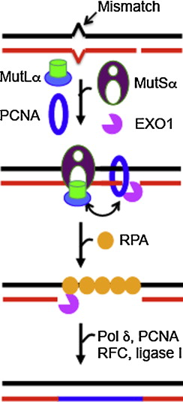
3’
Mismatch Repair
MutS2α MSH2-MSH6 --- recognition,
MutLα MLH1-PMS2
Nick induction

Slide 27
Chemotherapy
Name Action Cancer
Cychophoshamide Alkylating agents Breast Lung
Doxorubicin Intercalating agents Breast Lung
Cisplatin Intercalating agents Ovary Testis Stomach Bladder
Oxaliplatin Intercalating agents Colon Rectum
Bleomycin Generating free radicals Ovary Testis
Etoposide Inhibiting Topoisomerase II Ovary Testis

Slide 28
Etoposide stablizes Top2-DNA end complex.

Slide 29
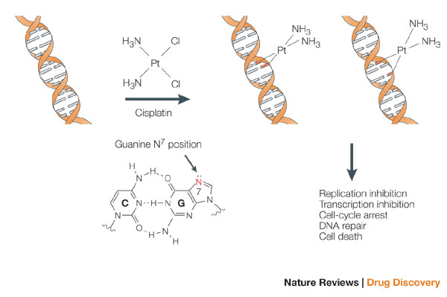

Slide 30
“ Checkpoint response“
DNA damage
processing
(repair proteins)
DNA repair
ATM
and
ATR
protein kinases
Tel1 and Mec1 in budding yeast
ATM and ATR are mutated in
ataxia-telangiecasia (A-T) and Seckel syndrome, respectively.
Chk1
and
Chk2
protein kinases
Chk1 and Rad53 in budding yeast
p53
Cell cycle arrest
Transcriptional activation
Apoptosis
Notes:
Cancer is a disease of our DNAs. Ramsar Iran 200 mSV/year
Overtime,dna accumulates changes that activate proto-oncognes and inactivate tumor-suppressor genes.
Unfortunately, we have to live without DNA damaging agents around, for example, UV in sunlight, reactive oxygen species dereived from respiration
In response to DNA damage, cells repair dna damage of course. At the same time, cells activate a variety of physiological responses, including
These responses are called checkpoint responses. Checkpoint is a signal transduction pathway.
Two large protein kinases, ATM and ATR act upstream and activate the downstream target Chk1 and Chk2.
This pathway is conserved among eukaryotes. For example, in budding yeast, ATM and ATR homologs are encoed by Tel1 and Mec1, respectively. Chk1 and Chk2 are correspondent to Chk1 and Rad53.
We have been studying how DNA damage is recognized by the checkpoint machinery using budding yeast as a model system.
First, environmental agents such as the ultraviolet (UV) component of sunlight and ionizing irradiation cause alterations in DNA structure.
We might be exposed to extensive irradiation if attacked by atomic bombs or if an atomic power plant is wreck.
We eat food for living, which may contain genotoxic chemical. We are breathing every 3 seconds. Reactive oxigen species derived from respiration are a permanent enemy to DNA. In response to DNA damage, cells repair the altered structure of DNA. In fact, cells are equipped with several types of repair machinery to cope with different types of damage. But the cellular response extends further. At the same time, cells activate a variety of physiological responses, including
These responses are sometimes called checkpoint responses. Checkpoint is a signal transduction pathway.
Two large protein kinases, ATM and ATR act upstream and activate the downstream target Chk1 and Chk2.
This pathway is conserved among eukaryotes. For example, in budding yeast, ATM and ATR homologs are encoed by Tel1 and Mec1, respectively. Chk1 and Chk2 are correspondent to Chk1 and Rad53.
We have been studying how DNA damage is recognized by the checkpoint machinery using budding yeast as a model system.

Slide 31
ATM interacts with the C-terminus of Nbs1.
ATM
ATM
MRE11-RAD50-NBS1 (MRN)
MRE11 is mutated in A-T like disorder,
and NBS1 is mutated in Nijmegen breakage syndrome.
Notes:
The Mre11 complex binds to ATM or Tel1 and as a result ATM localizes to DSB ends.

Slide 32
Human
Mec1^{ATR} forms a complex with Ddc2^{ATRIP}.
Mec1-Ddc2 localizes to sites of DNA damage
by interacting with RPA.
ATR
ATRIP
RPA
RPA
RPA

Slide 33
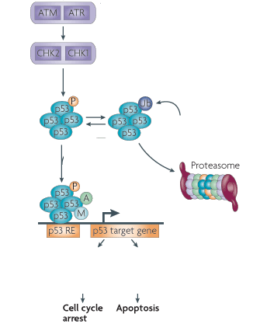
MDM2
FAS
Bcl2-binding component 3 (Bbc3)
Bcl6
CDKN1A (P21, Cip1)
GADD45

Slide 34
Chemotherapy and irradiation induce DNA damage
Chemotherapy -> DNA damage → checkpoint activation
and loss of essential genes → cell death
------mutations in essential genes → Cell death
------mutations in DNA repair genes → irreparable →cell death
------apoptosis →cell death
Chemotherapy -> DNA damage → mutation
→ Cancer development

Slide 35
http://www.pbs.org/kenburns/cancer-emperor-of-all-maladies/watch-video/
http://www.cancer.gov

