Slide 1
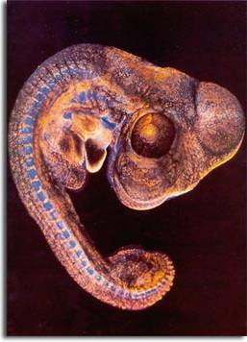
[INSERT LEARNING EVENT TITLE]
©Feinberg and Holmes, 1985
[Insert image or animation that illustrates unit topic]
[Insert Subtitle/Faculty Name here]
Notes:
Start your presentation off with an interesting graphic to capture the learners’ attention. Replace this image with your own image, or if you are not using one, delete this one and enlarge the Subtitle/Faculty name.
Note: Font and point sizes recommended are: Arial, pts. Size 36-44 for titles, smaller point sizes for sub-headings – 24 pt. Point sizes smaller than 18 are difficult to view from the back of the room.
Also, background colors are optional but can be helpful, especially if creating a theme. When using a background, use dark backgrounds with light letters and light backgrounds with dark letters. Try to avoid using patterns or multi-colored backgrounds.

Slide 2
At the end of the session you should be able to:
Objectives
[Insert approx. 4-8 objectives depending on length of content. Examples of how to start objective statements:]
Describe…
Compare and contrast…
Explain…
Define…
State…
Give examples of…
Notes:
The second slide is a NJMS requirement: the learning/behavioral objectives of the lesson.
The objectives provide the structure and expectations of the lecture. They should state what the learner should be able to do or know at the end of the lecture. Begin with verbs that describe a behavior that the learner can actually do and be observed doing to demonstrate they have learned the content.
Try to provide a variety of different objectives. The verbs in the slide are common examples.
Quizzes and exams measure that a learner can achieve the objectives.
RESOURCE LINK : For more information on writing objectives, right click on the link below and select Open Hyperlink to go to the page that describes how to write objectives. You will need to enter the Username: Faculty and Password: development2013 to access this Faculty Development website page.

Slide 3
[Insert Purpose Title or “Lesson Purpose”]
Purpose & Integration
[this slide is about integration across the curriculum. Insert a title that reflects the purpose of the lesson]
[Insert overall key concepts covered in this session.]
[With a few bullets, outline any linkages to similar and related content in previous or upcoming sessions – i.e., “this builds on previous content learned… or this will introduce content you will revisit later in...”]
[With a few bullets, put in context to clinical medicine]
Notes:
In a few bullets provide the overall purpose and reason why this module is important and how it relates to the learner’s medical education.
Also describe the relationship of the material in your course to the material in preceding and subsequent courses. In other words, where does your course build on previous content and what subsequent courses or clerkships build on yours?
Emphasize how this content relates to clinical medicine.
RESOURCE LINK  For more information on topics that are included in other lectures, you can search on different course materials in Socrates. Right click on the link below and select Open Hyperlink to go to the NJMS Intranet login. Login with your Core Username and Password, the go to SOCRATES.
https://intra.njms.rutgers.edu/intraLogin/index.cfm

Slide 4
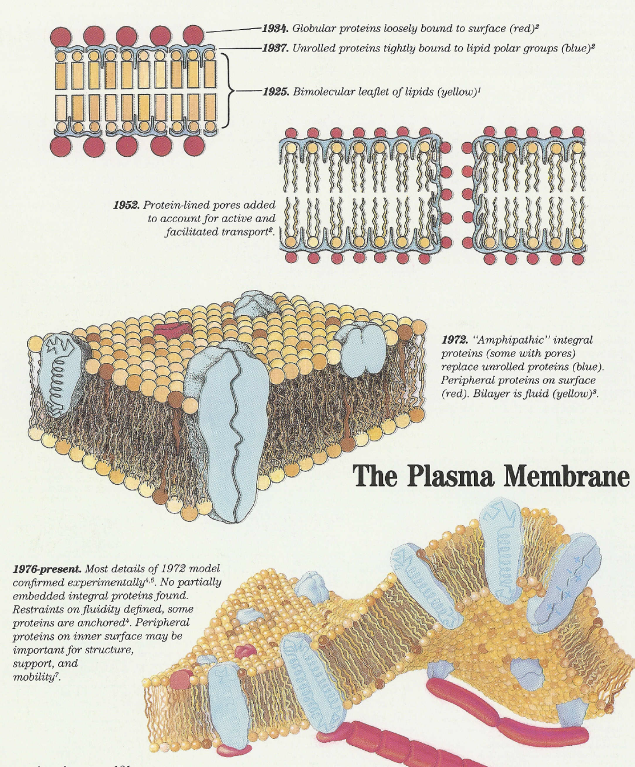
[Insert: Background/History Heading]
Background
Notes:
INTRODUCTION - BACKGROUND/HISTORY:
If there is time, you may want to include a brief summary of the history/background of the topic. If possible, include an image.
This places material into an historical perspective.
It also emphasizes the changes that occur in science and medicine and therefore, the need for life-long learning.

Slide 5
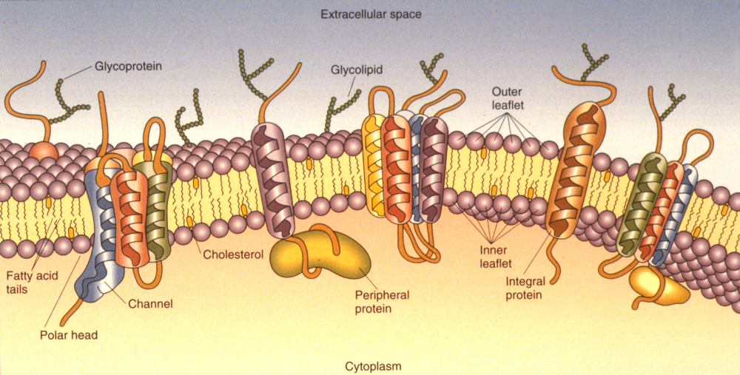
[i.e., for this slide: Identify the components of the plasma membrane]
First objective/key concept
[Insert: First objective statement]
[Insert key points, labels with bullets]
Lipid Bilayer
Proteins
Cell Coat
Notes:
Insert a title related to the first topic/first objective. (Example: if your first objective is to identify the components of the plasma membrane, then use that as the title).
Include content that focuses the learner on what they need to know/do in order to achieve the first objective.
When determining what to focus on, consider providing time on the most difficult concepts.
If you have content that could potentially be a review for the learner, or is basic content, consider creating an introduction podcast. Then, start with an interactive exercise reviewing what they learned in the podcast.
Use Arial, pt. size 36 – 44 for titles, smaller point sizes for subheadings and lecturer and dates, i.e., 24 pt. Point sizes smaller than 18 are difficult to view from the back of the room.
Include a colorful image to depict the topic.
Clearly label the different parts and functions.
Use bulleted text in 18 point size or higher. Animate the bullets, brining them in one at a time to help with focusing on what you will describe.
Note: If there are many new terms, you might want to include a glossary of terms on Moodle, and leave these out of the lecture.

Slide 6
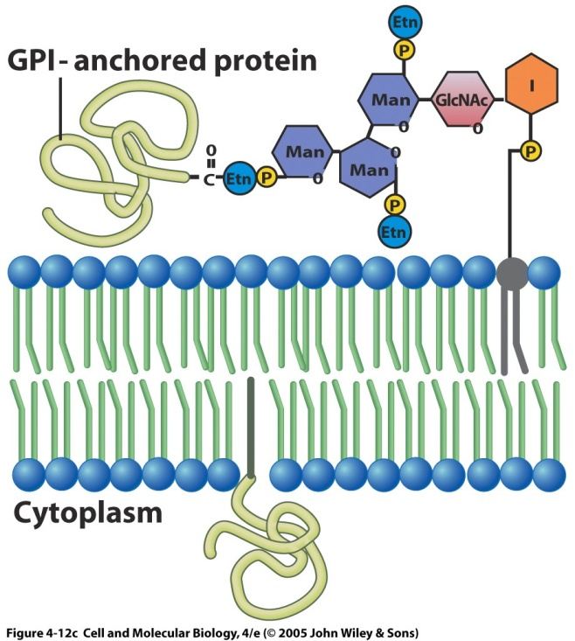
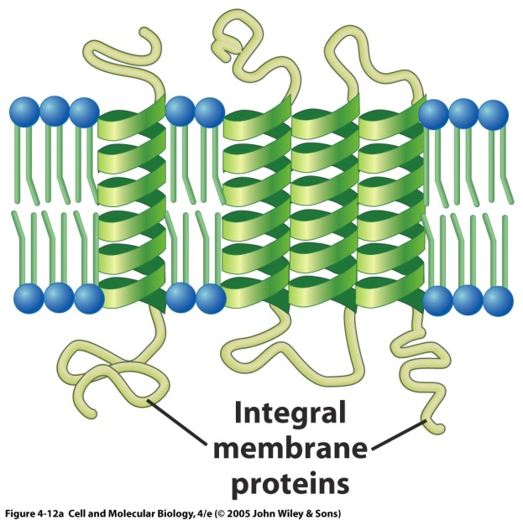
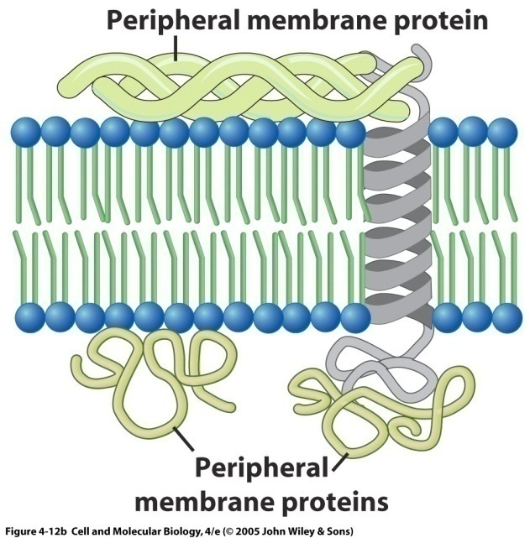
Details to support first key concept
[Insert: Sub-heading]
[i.e., more detailed content that supports the first objective]
Integral
(Transmembrane)
Peripheral
Lipid-anchored
Notes:
Include 2-3 slides of detail to support the key objectives/concepts.
Clearly and simply illustrate the key points.
Use Arial, pt. size 36 – 44 for titles, smaller point sizes for subheadings and lecturer and dates, i.e., 24 pt.
Note: If you need more than one detail slide, duplicate this slide and continue.
If you need more than 3 detail slides, this is a good time to think about creating a podcast or learning activity outside of class elaborate on the details more effectively.

Slide 7
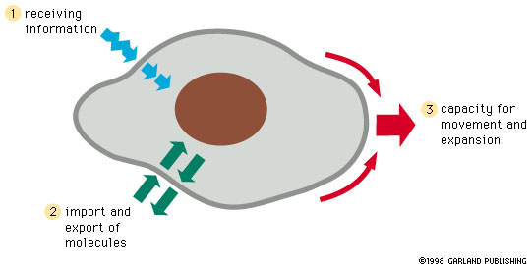
[Insert: Second objective statement]
Second Objective/Key Concept
[Insert key point here]
[Insert key point here]
[Insert key point here]
[Insert key point here]
Notes:
Insert a title related to the second objective.
Focus again on what the learner needs to know/do in order to be able to achieve the next objective.
Include supporting details in an additional slide.
Use Arial, pt. size 36 – 44 for titles, smaller point sizes for subheadings and lecturer and dates, i.e., 24 pt. Point sizes smaller than 18 are difficult to view from the back of the room.
Note: When determining which concepts to focus on in class, cover those that are most complex and that learners have the most difficulty with
Consider creating a podcast if the content is very complex and requires additional time/material. (A 15-minute podcast or no more than a 45-minute reading assignment is suggested.) For more information on creating podcasts, consult the Podcast checklist under Tools and Resources to Create Courses on the Faculty development website using the link below:
You will need to enter the User ID: Faculty and Password: development2013:
http://njms.rutgers.edu/education/office_education/faculty/welcome.cfm

Slide 8
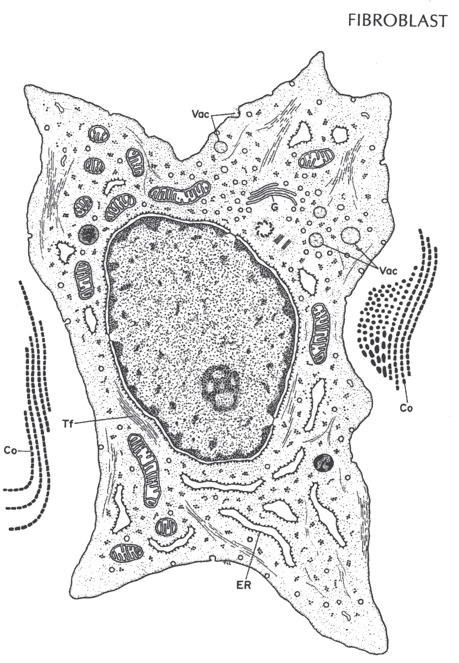
Analogy/Example
[Here is a fibro-blast – see next slide for analogy]
Notes:
Use examples, analogies and clinical correlations to help students comprehend and retain content better.
If you discuss a difficult concept or display a chart that shows a formula, use an example that shows how this concept or formula is used.
Example above: Fibroblast – a cell that synthesizes small precursor molecules (procollagen) that are secreted and then assembled outside the cell in the Extracellular Matrix (ECM) where they form giant extracellular fibrillar structures (Collagen fibers). The following slide provides an example of an analogy….

Slide 9
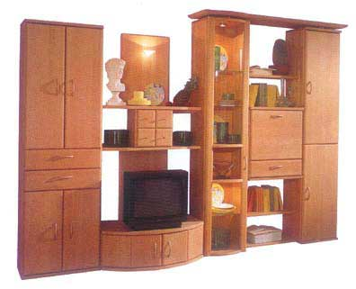

[Insert: An Example or Analogy]
[i.e., for this graphic Collagen: Some Assembly Required]
Analogy/Example
Fibroblast
Cell
Extracellular Matrix
Notes:
Example Above: The analogy of a piece of furniture that comes in a box, but when opened up and assembled outside of the box it becomes much larger then the box it came in. A fibroblast secretes the precursor molecules of collagen. These precursors are assembled outside the cell in the expansive extracellular matrix where they can obtain a final size that is many times larger than the cell from which they originated – much like the wall unit that previously fit in the relatively small carton.

Slide 10
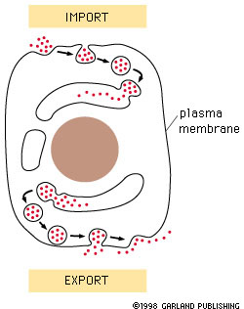
Third Objective/Key Concept
[Insert: Third major objective/concept]
[insert label]
[insert label]
[Insert image label]
Notes:
Insert a title related to the third objective/concept.
Focus on what the learner needs to know/do to accomplish the third objective.
Use another detail slide for additional information, if necessary.

Slide 11
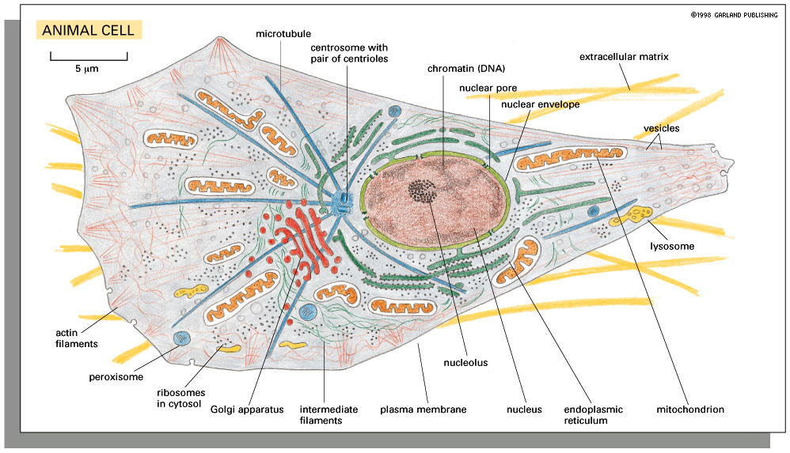
[Insert a question]
[i.e.,: Where is the Glycocalyx?]
Engage with Interactivity
Virtual Cell Video
Notes:
Include an interaction or engaging activity. This is an example of a question and a short video clip. The video clip used here is purely an example, but demonstrates how to include a link to a video.
Insert a question related to the concept/objective. Ask the students to answer it. Even if they do not provide the correct answer, it provides them with a way to become engaged in their learning.
You can insert the video, perhaps a YouTube video, right in your slide. You must be in Slide Show mode for this to work.
Other interactivities include using the Audience Response System, Write/Pair/Share, or Jeopardy/Games.
When considering the type of interaction you want to use, consider the time you have and the objectives. The time will dictate the available length of your activity. The type of activity should match what the objective requires. For instance if the objective is to “Identify the different cells” then, the activity should also require the learner to identify the different cells. This can be in form of answering questions to label different parts of an image, or listing the different parts, using ARS or other game.

Slide 12
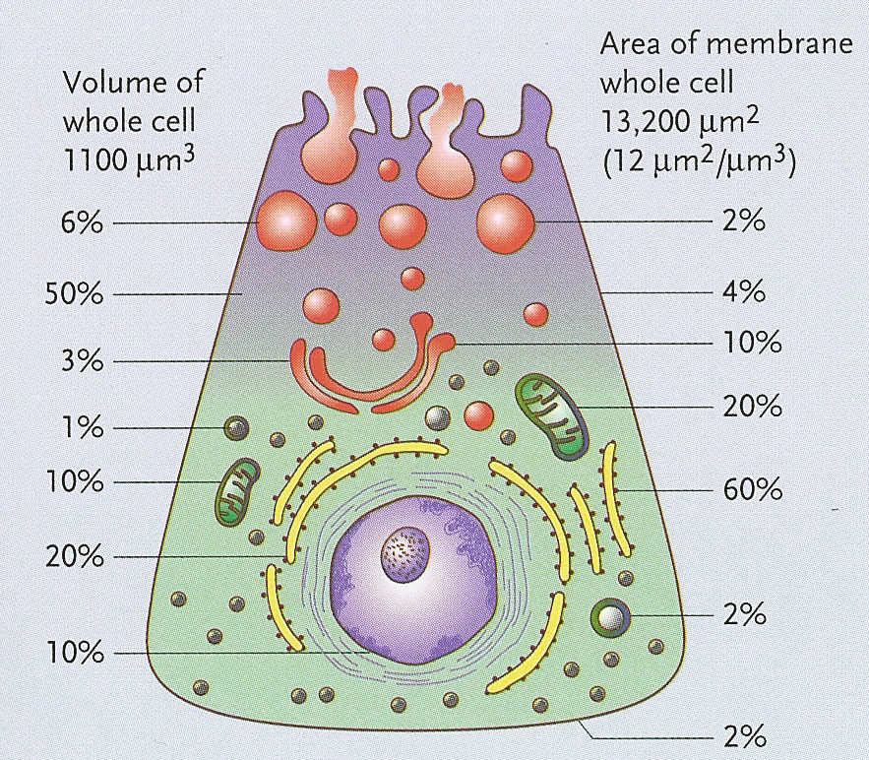
Fourth Objective/Key Concept
[Insert: Fourth major objective/concept]
Notes:
Insert a title related to the fourth concept/objective.
Follow the same design and content guidelines as the first three key concepts.
Copy additional Key Concept and Details Slides as needed.

Slide 13
Upcoming Topics/Resources
Integration and Additional Resources
Upcoming Related Topics:
[Insert a few bullets on upcoming related topics either in this lecture or in upcoming sessions.]
Additional Resources:
[Also, add supplementary resources and literature cited – such as Review Podcasts, where they can find additional information on this topic].
[Insert resource]
[Insert resource]
Notes:
If appropriate, refer to how this lecture content integrates with the next or upcoming lectures (what they will be learning next that builds on this).
If appropriate provide additional or supplementary resources, such as literature, review podcasts available on Moodle or other external web sites.
RESOURCE  : SOCRATES may be helpful here. Right click on the link below and select Open Hyperlink to go to the NJMS Intranet login. Login with your Core Username and Password, the go to SOCRATES.
https://intra.njms.rutgers.edu/intraLogin/index.cfm

Slide 14
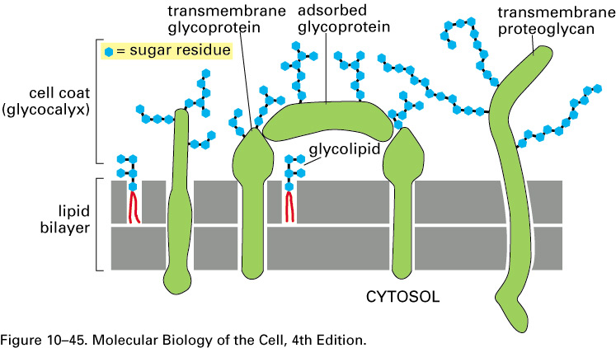
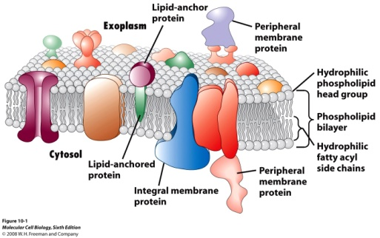
[Insert Topic Summary]
Summary
Insert Key Images here
[Insert key points with corresponding images.]
[Insert key point covered in lecture]
[Insert key point covered in lecture]
[Insert key point covered in lecture]
[Insert key point covered in lecture]
[Insert key point covered in lecture]
Notes:
Summarize the key points of the lecture by providing bulleted points and corresponding images that were used within the lecture.
Identify the most critical points to review and the most compelling images that portray these points.
Use Animation to link the bulleted point with a thumbnail view of the image in the top right corner. As you click through the bullets, the new corresponding image will appear in the top right screen.

Slide 15

[Optional: Review]
[Insert first Question here]
Review Questions
True
False
Notes:
Insert review question(s) – one for each slide.
If time, a quick review of the key points can also be done by asking the learners to respond to questions, using Audience Response System or other methods.
Include questions that are focused on the key concepts and are aligned with the objectives.
You can also use games, such as Jeopardy questions. Also, PowerPoint has a multiple choice Quiz Template that can also be used for Review slides.
Reviews can also be done as a self-paced activity online and may be more practical in terms of lecture time and for practice outside of class.
Include examples of questions from NBME subject exams and USMLE to help students synthesize the course content into integrated exams.
Lastly, don’t forget to proof read and spell-check the presentation. This may seem obvious, but oftentimes, when in a rush, it is easy to overlook this last step and erroneous information is more difficult to correct later.
END OF TEMPLATE

